Slide 2
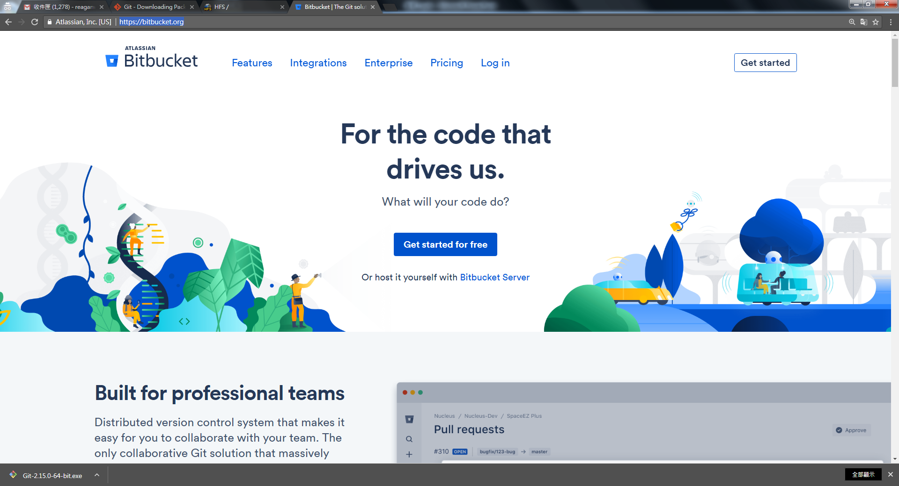
https://bitbucket.org/

Slide 3
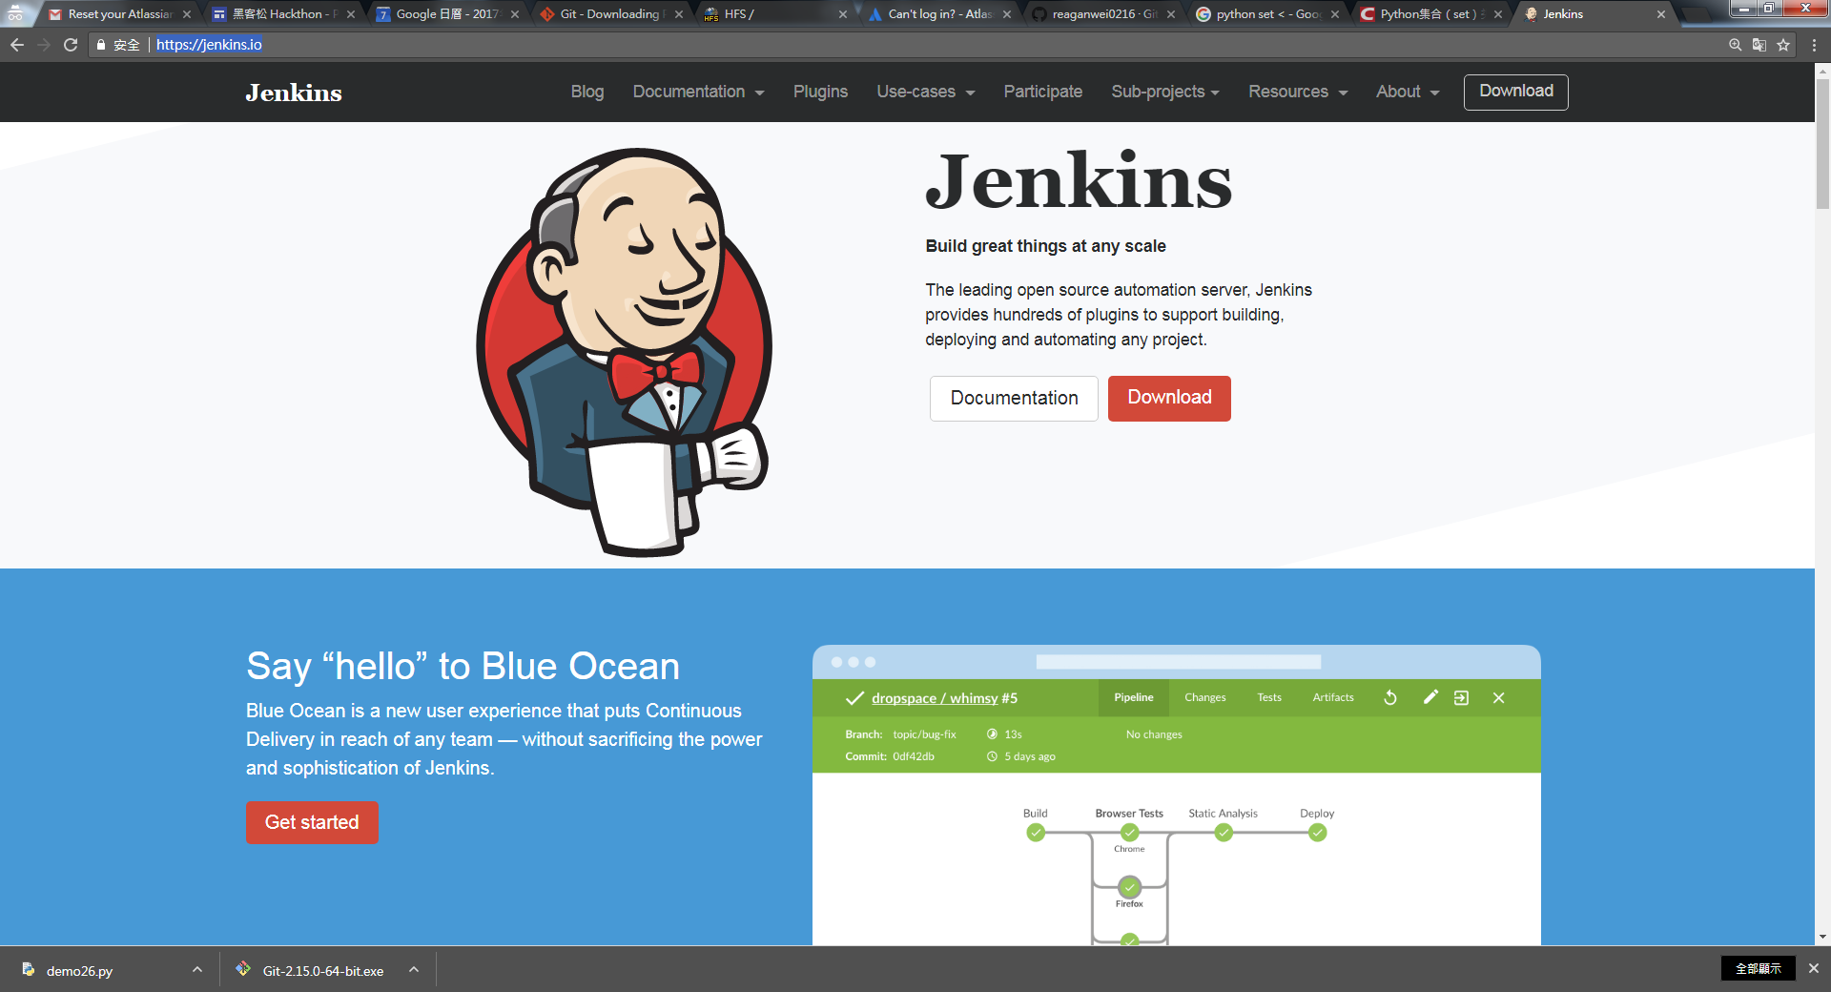
https://jenkins.io/

Slide 4
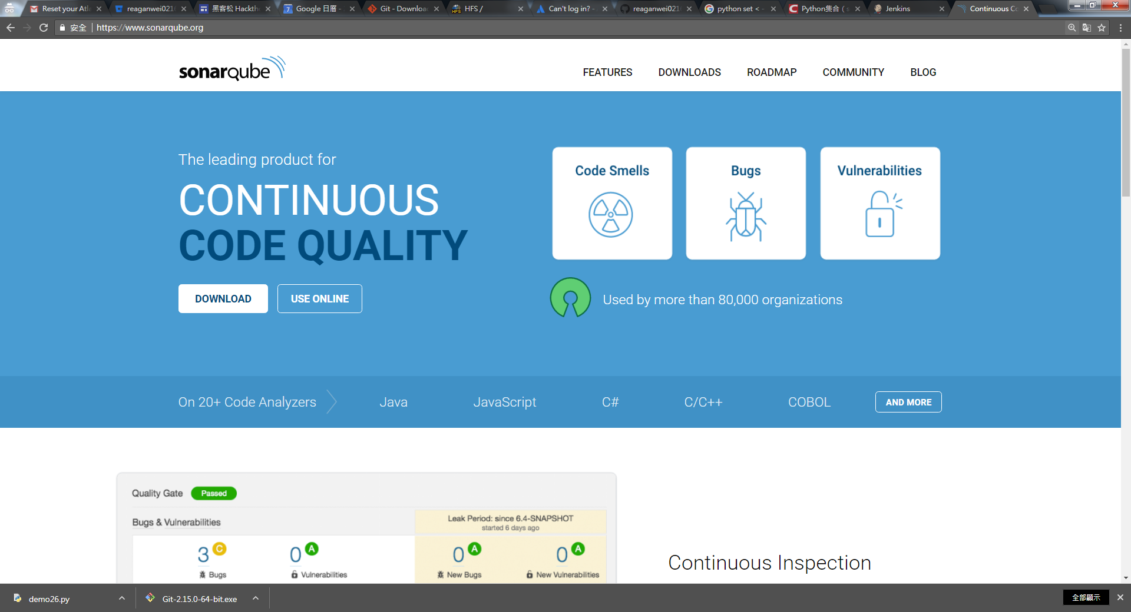
https://www.sonarqube.org/

Slide 5
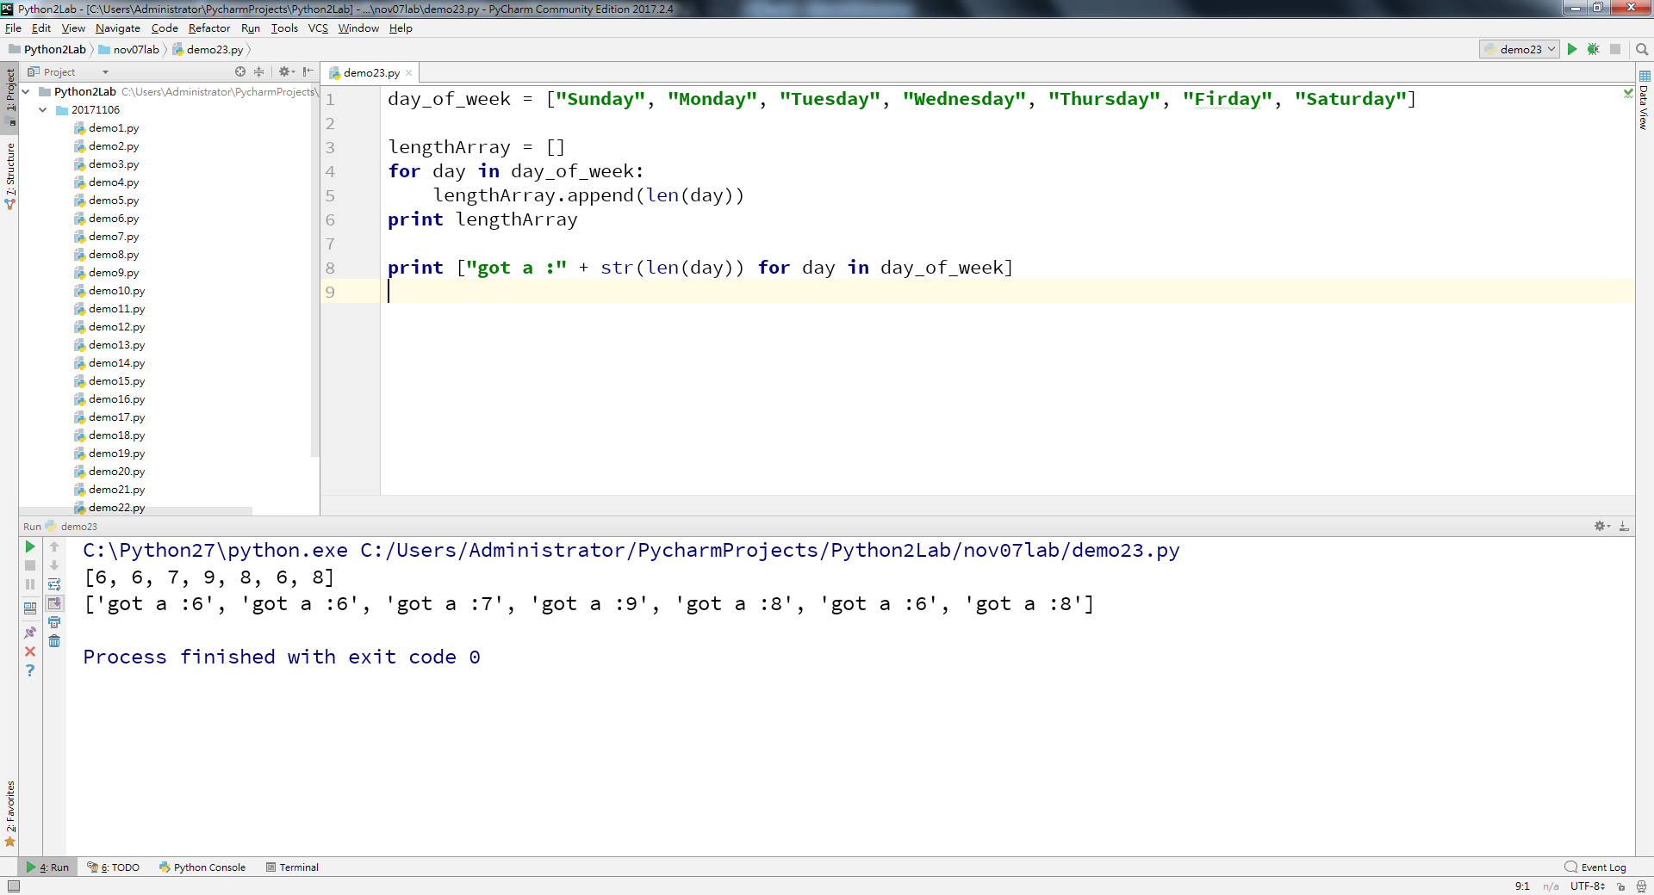
py2

Slide 6
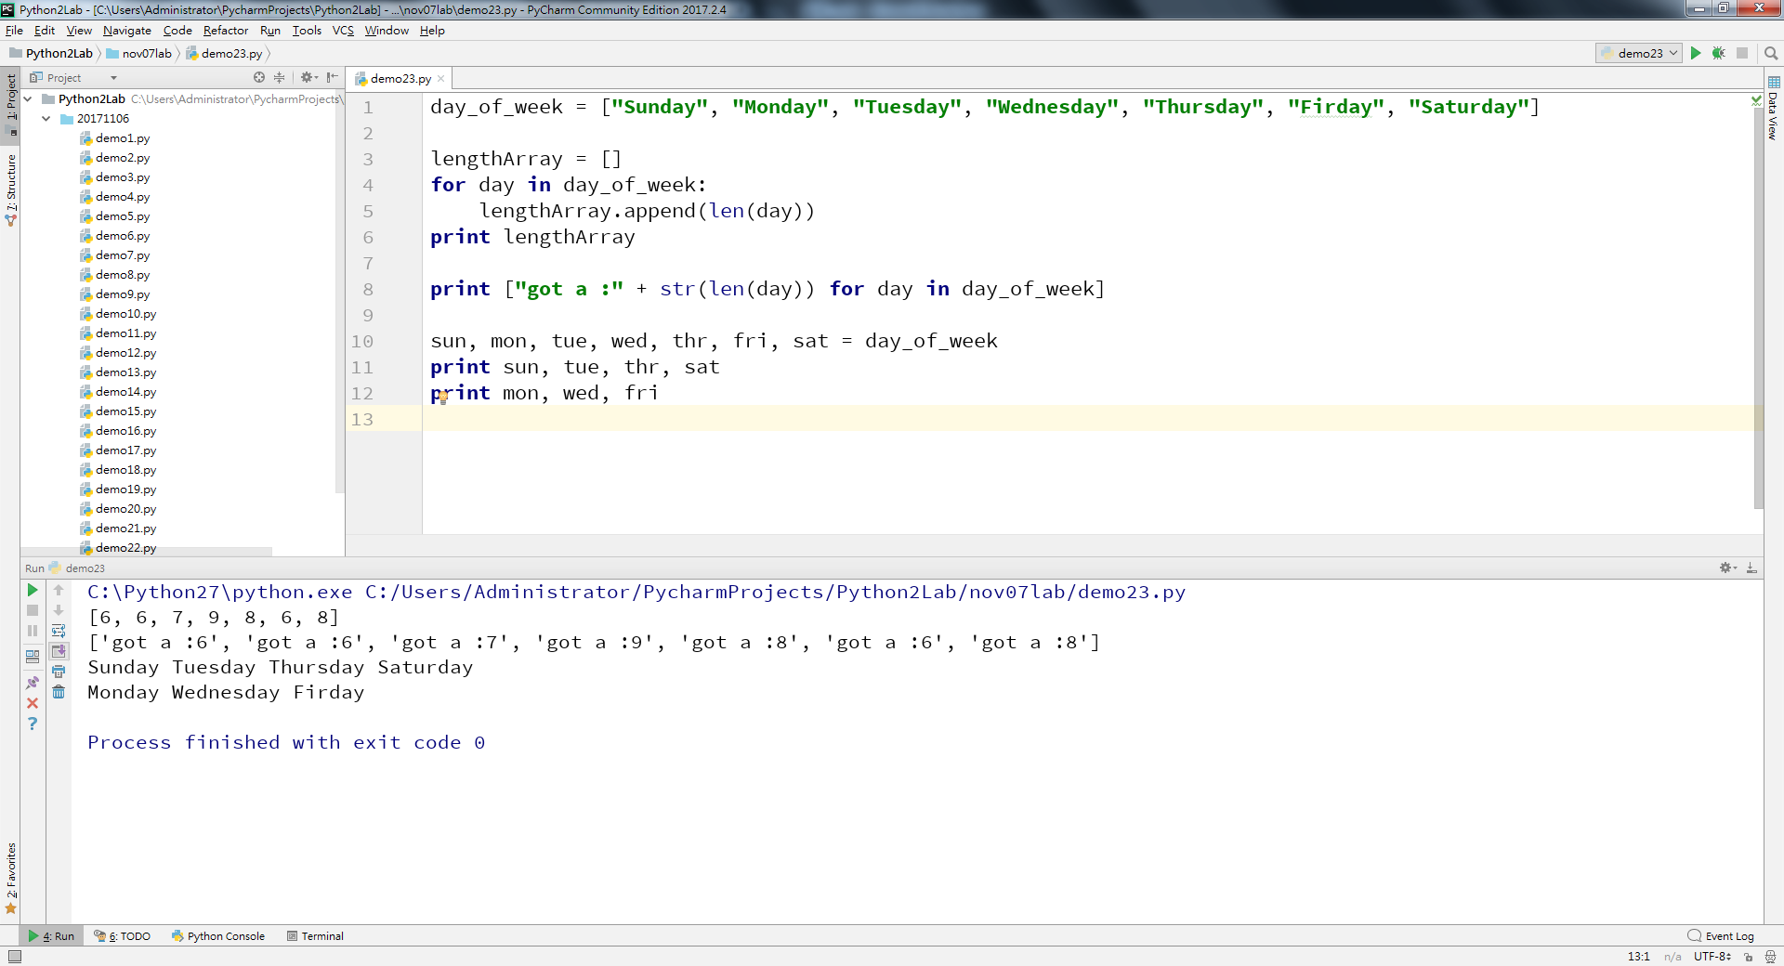
py2

Slide 7
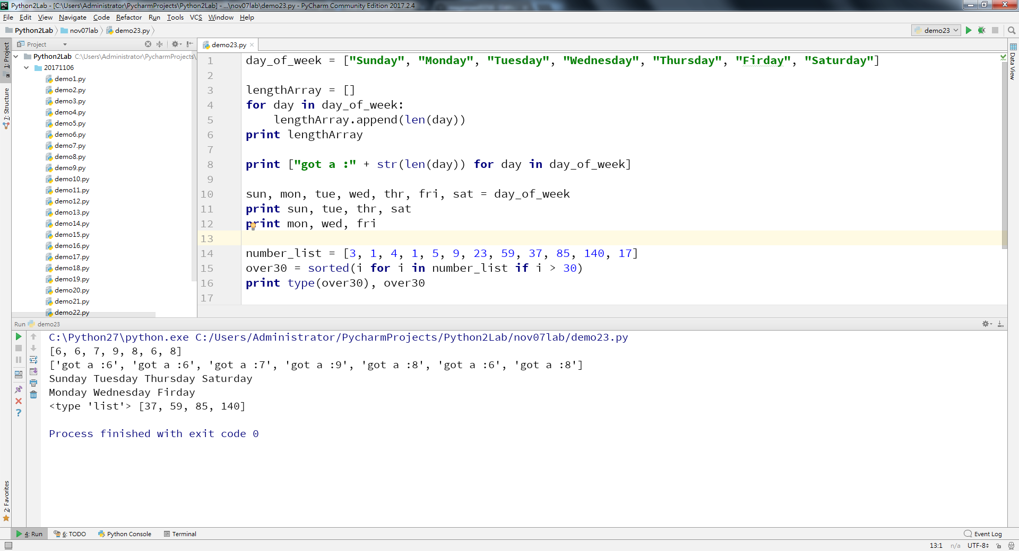
py2

Slide 8
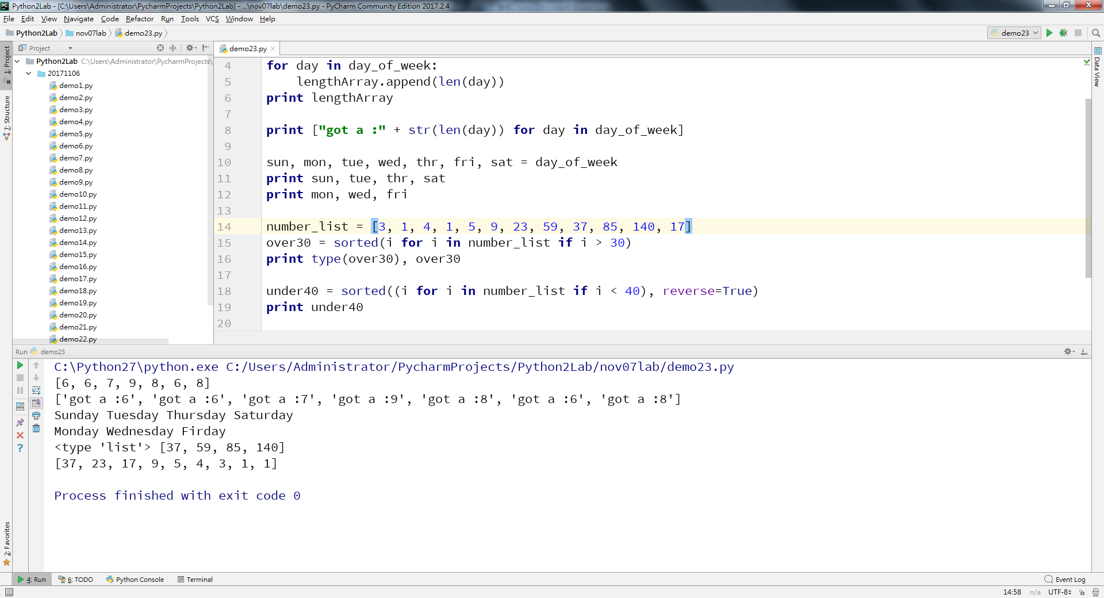
py2

Slide 9
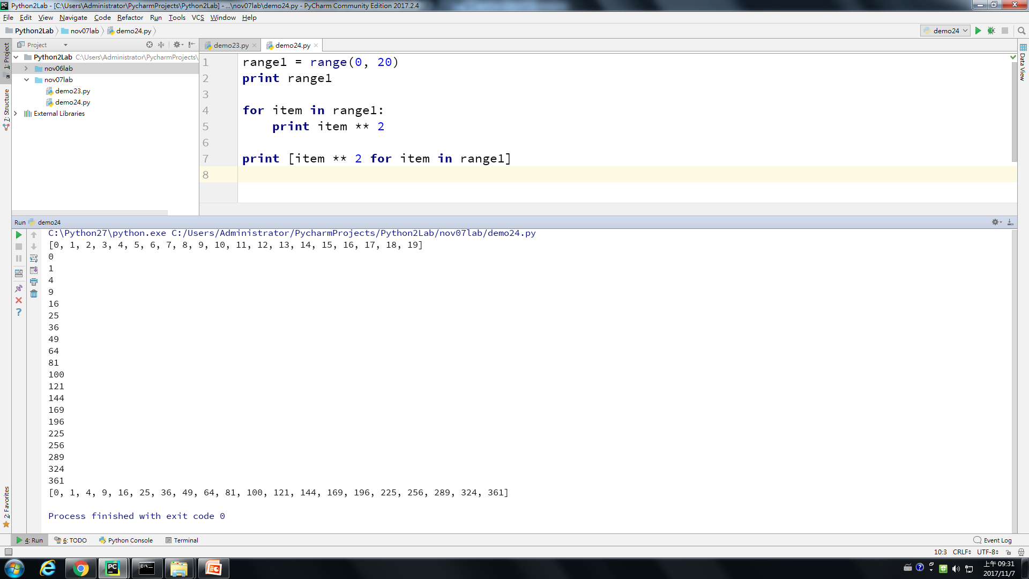
py2

Slide 10
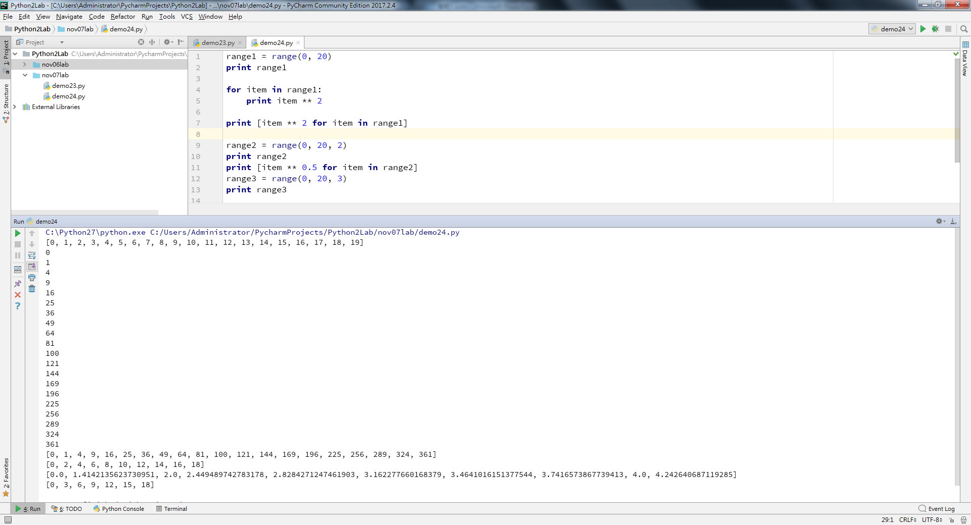
py2

Slide 11
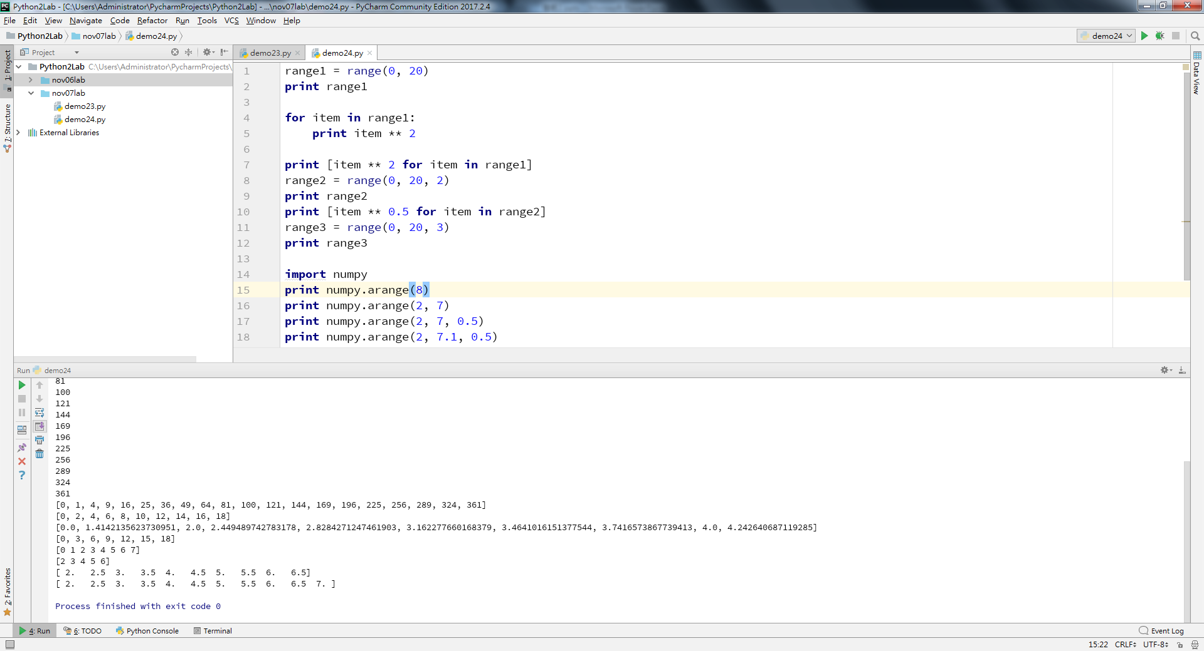
py2

Slide 12
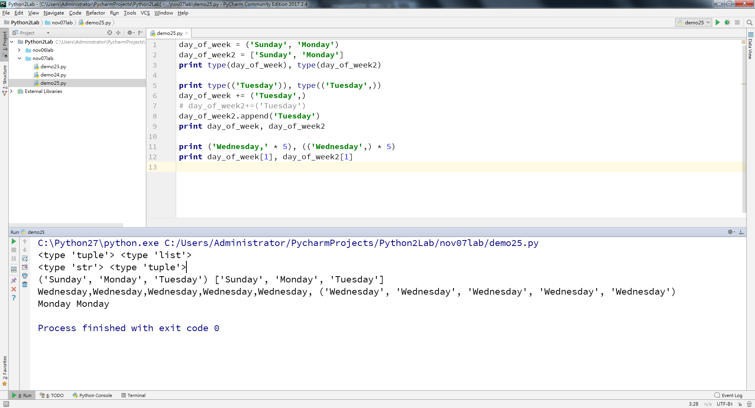
py2
Notes:
day_of_week = ('Sunday', 'Monday') day_of_week2 = ['Sunday', 'Monday'] print type(day_of_week), type(day_of_week2) print type(('Tuesday')), type(('Tuesday',)) day_of_week += ('Tuesday',) # day_of_week2+=('Tuesday') day_of_week2.append('Tuesday') print day_of_week, day_of_week2 day_of_week3 = 'Sunday,Monday,Tuesday' print ('Wednesday,' * 5), (('Wednesday',) * 5) print day_of_week[1], day_of_week2[1] print 'day' in day_of_week, 'Sunday' in day_of_week print 'day' in day_of_week3, 'Sunday' in day_of_week3

Slide 13
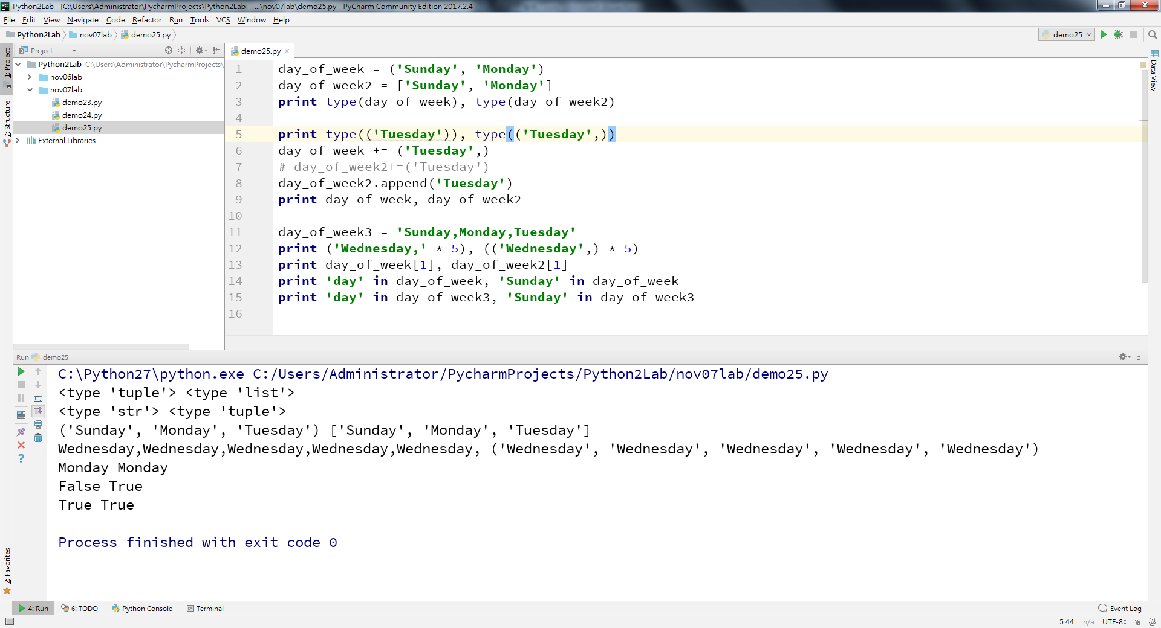
py2
Notes:
day_of_week = ('Sunday', 'Monday') day_of_week2 = ['Sunday', 'Monday'] print type(day_of_week), type(day_of_week2) print type(('Tuesday')), type(('Tuesday',)) day_of_week += ('Tuesday',) # day_of_week2+=('Tuesday') day_of_week2.append('Tuesday') print day_of_week, day_of_week2 day_of_week3 = 'Sunday,Monday,Tuesday' print ('Wednesday,' * 5), (('Wednesday',) * 5) print day_of_week[1], day_of_week2[1] print 'day' in day_of_week, 'Sunday' in day_of_week print 'day' in day_of_week3, 'Sunday' in day_of_week3

Slide 14
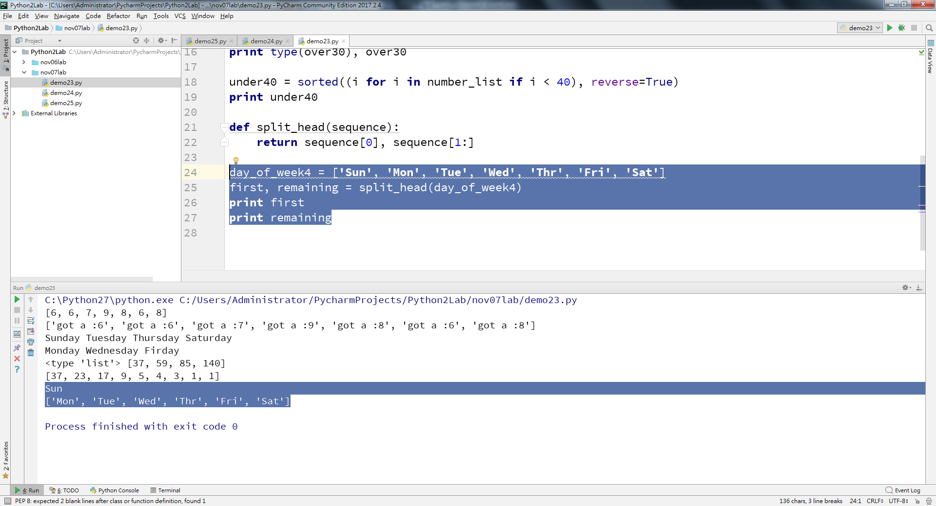
py2
Notes:
day_of_week = ('Sunday', 'Monday') day_of_week2 = ['Sunday', 'Monday'] print type(day_of_week), type(day_of_week2) print type(('Tuesday')), type(('Tuesday',)) day_of_week += ('Tuesday',) # day_of_week2+=('Tuesday') day_of_week2.append('Tuesday') print day_of_week, day_of_week2 day_of_week3 = 'Sunday,Monday,Tuesday' print ('Wednesday,' * 5), (('Wednesday',) * 5) print day_of_week[1], day_of_week2[1] print 'day' in day_of_week, 'Sunday' in day_of_week print 'day' in day_of_week3, 'Sunday' in day_of_week3

Slide 15
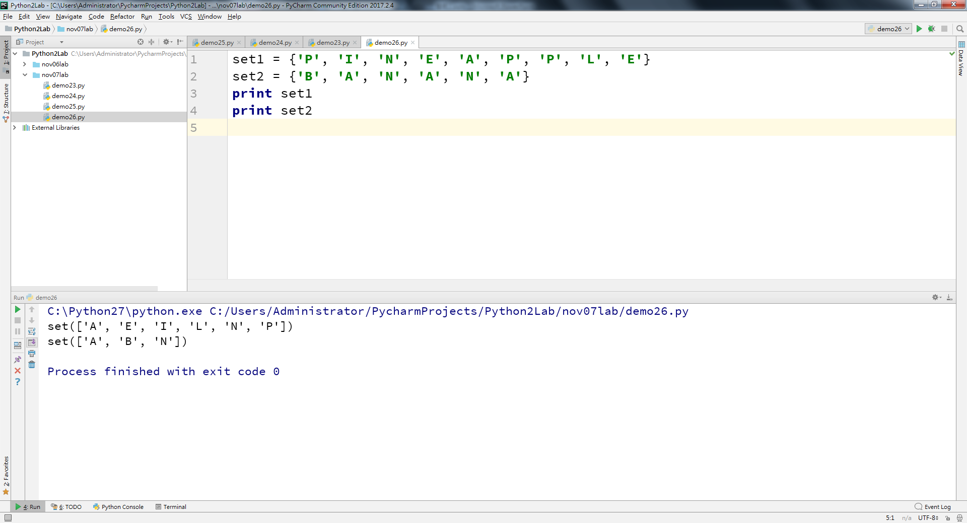
py2

Slide 16
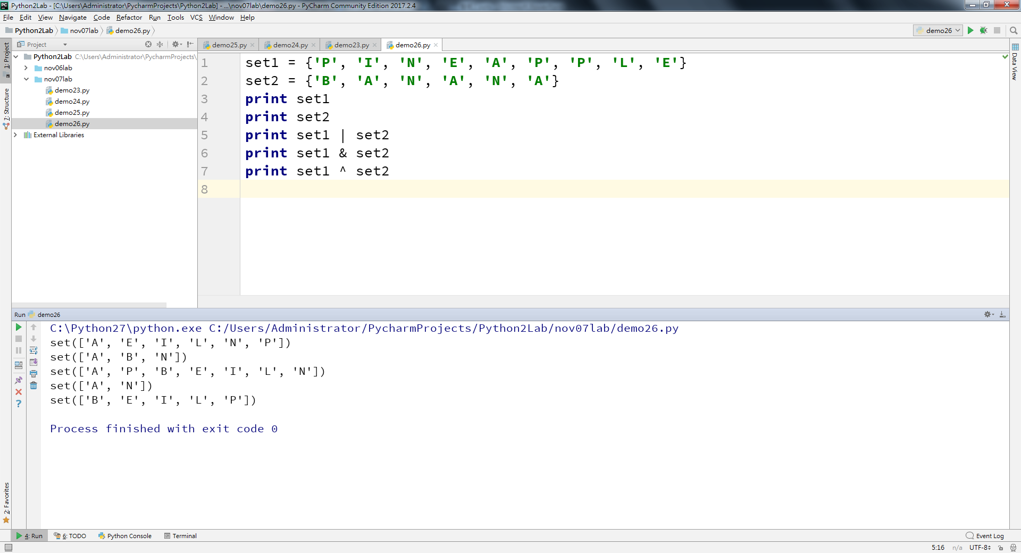
py2
Notes:
set1 = {'P', 'I', 'N', 'E', 'A', 'P', 'P', 'L', 'E'} set2 = {'B', 'A', 'N', 'A', 'N', 'A'} print set1 print set2 print set1 | set2 print set1 & set2 print set1 ^ set2

Slide 17
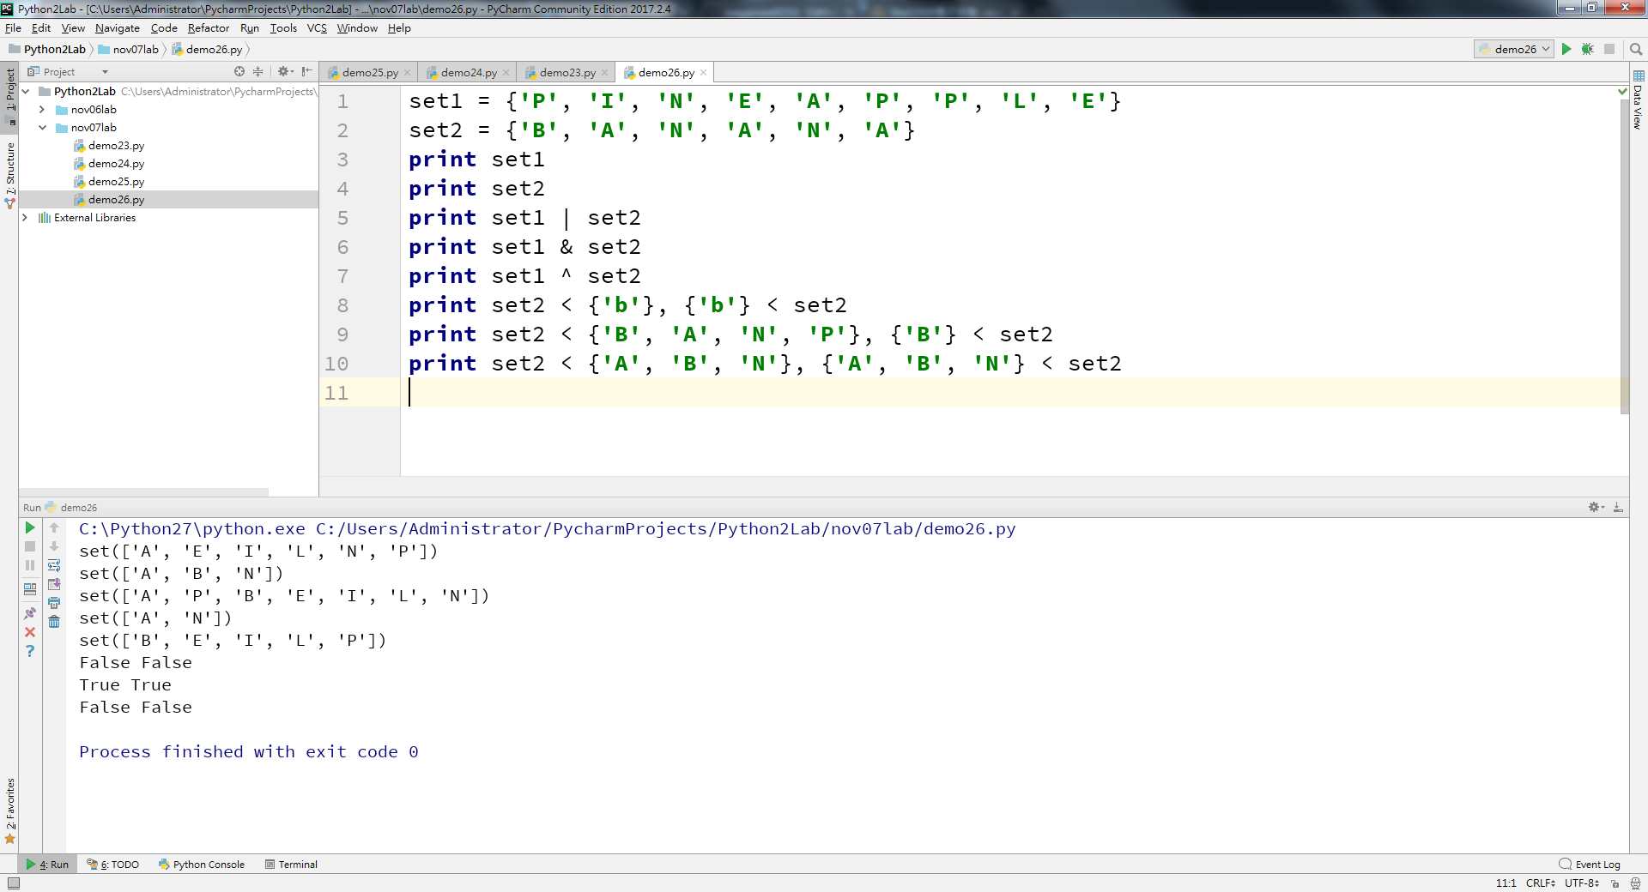
py2

Slide 18
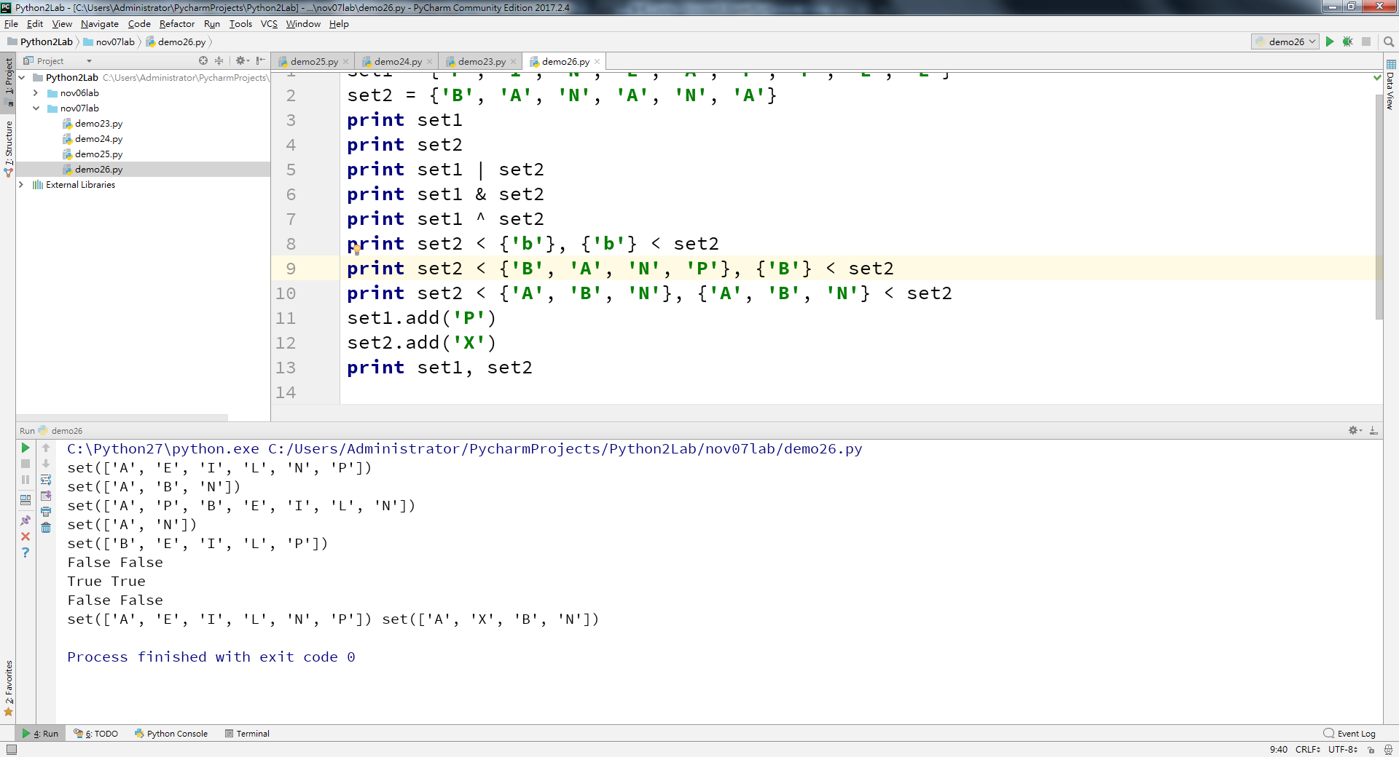
py2
Notes:
set1 = {'P', 'I', 'N', 'E', 'A', 'P', 'P', 'L', 'E'} set2 = {'B', 'A', 'N', 'A', 'N', 'A'} print set1 print set2 print set1 | set2 print set1 & set2 print set1 ^ set2 print set2 < {'b'}, {'b'} < set2 print set2 < {'B', 'A', 'N', 'P'}, {'B'} < set2 print set2 < {'A', 'B', 'N'}, {'A', 'B', 'N'} < set2 set1.add('P') set2.add('X') print set1, set2

Slide 19
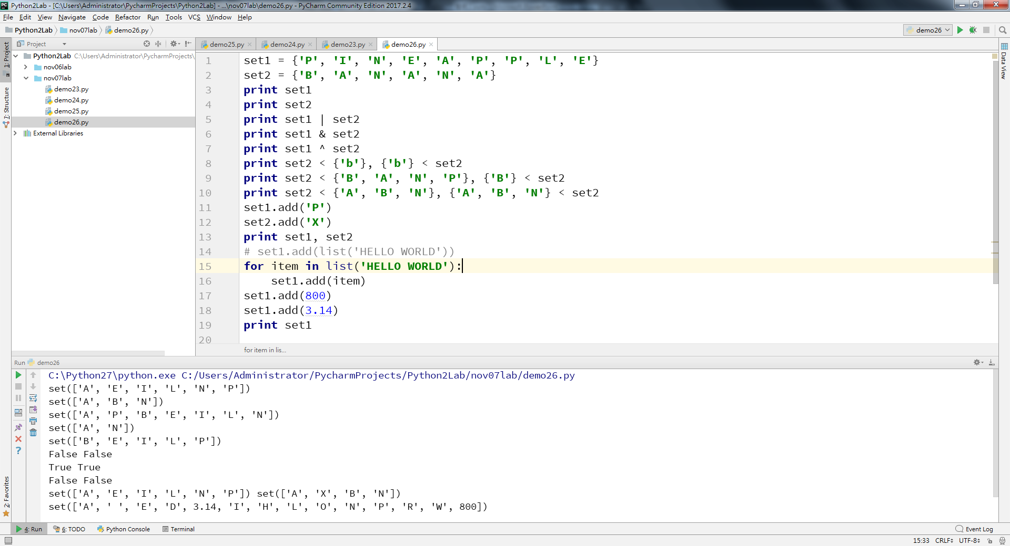
py2
Notes:
set1 = {'P', 'I', 'N', 'E', 'A', 'P', 'P', 'L', 'E'} set2 = {'B', 'A', 'N', 'A', 'N', 'A'} print set1 print set2 print set1 | set2 print set1 & set2 print set1 ^ set2 print set2 < {'b'}, {'b'} < set2 print set2 < {'B', 'A', 'N', 'P'}, {'B'} < set2 print set2 < {'A', 'B', 'N'}, {'A', 'B', 'N'} < set2 set1.add('P') set2.add('X') print set1, set2 # set1.add(list('HELLO WORLD')) for item in list('HELLO WORLD'): set1.add(item) set1.add(800) set1.add(3.14) print set1

Slide 20
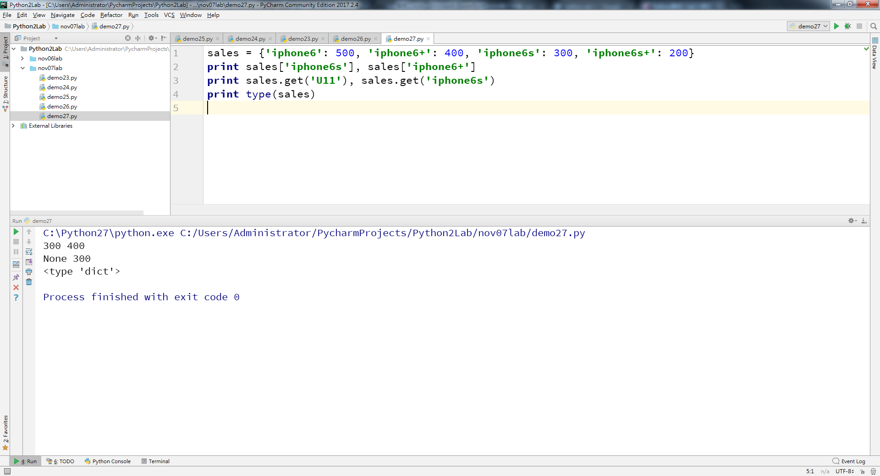
py2
Notes:
sales ={'iphone6':500,'iphone6+':400,'iphone6s':300,'iphone6s+':200} print sales['iphone6s'],sales ['iphone6+'] print sales.get('U11'),sales.get('iphone6s') print type (sales)

Slide 21
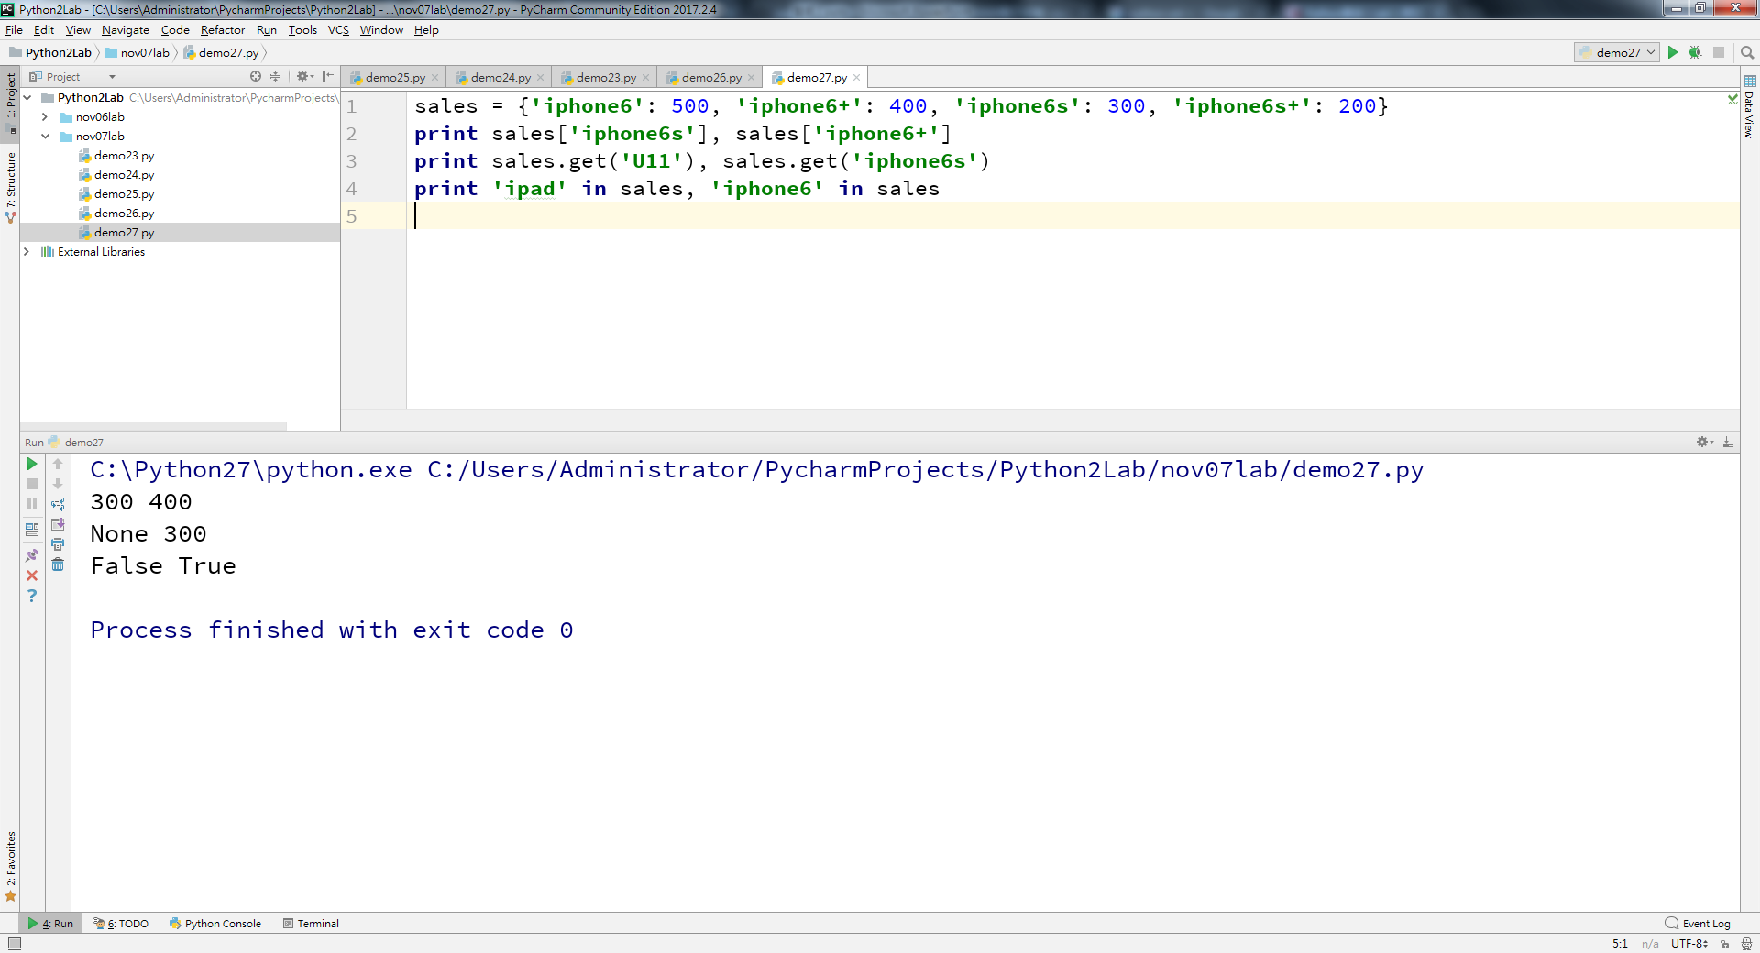
py2

Slide 22
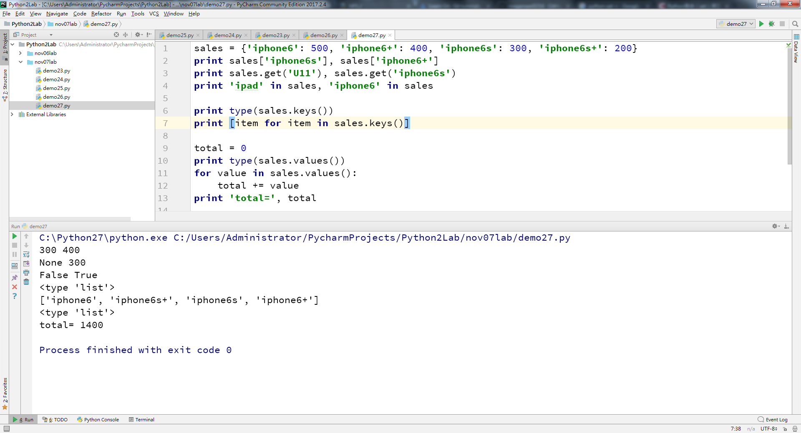
py2
Notes:
sales = {'iphone6': 500, 'iphone6+': 400, 'iphone6s': 300, 'iphone6s+': 200} print sales['iphone6s'], sales['iphone6+'] print sales.get('U11'), sales.get('iphone6s') print 'ipad' in sales, 'iphone6' in sales print type(sales.keys()) print [item for item in sales.keys()] total = 0 print type(sales.values()) for value in sales.values(): total += value print 'total=', total

Slide 23
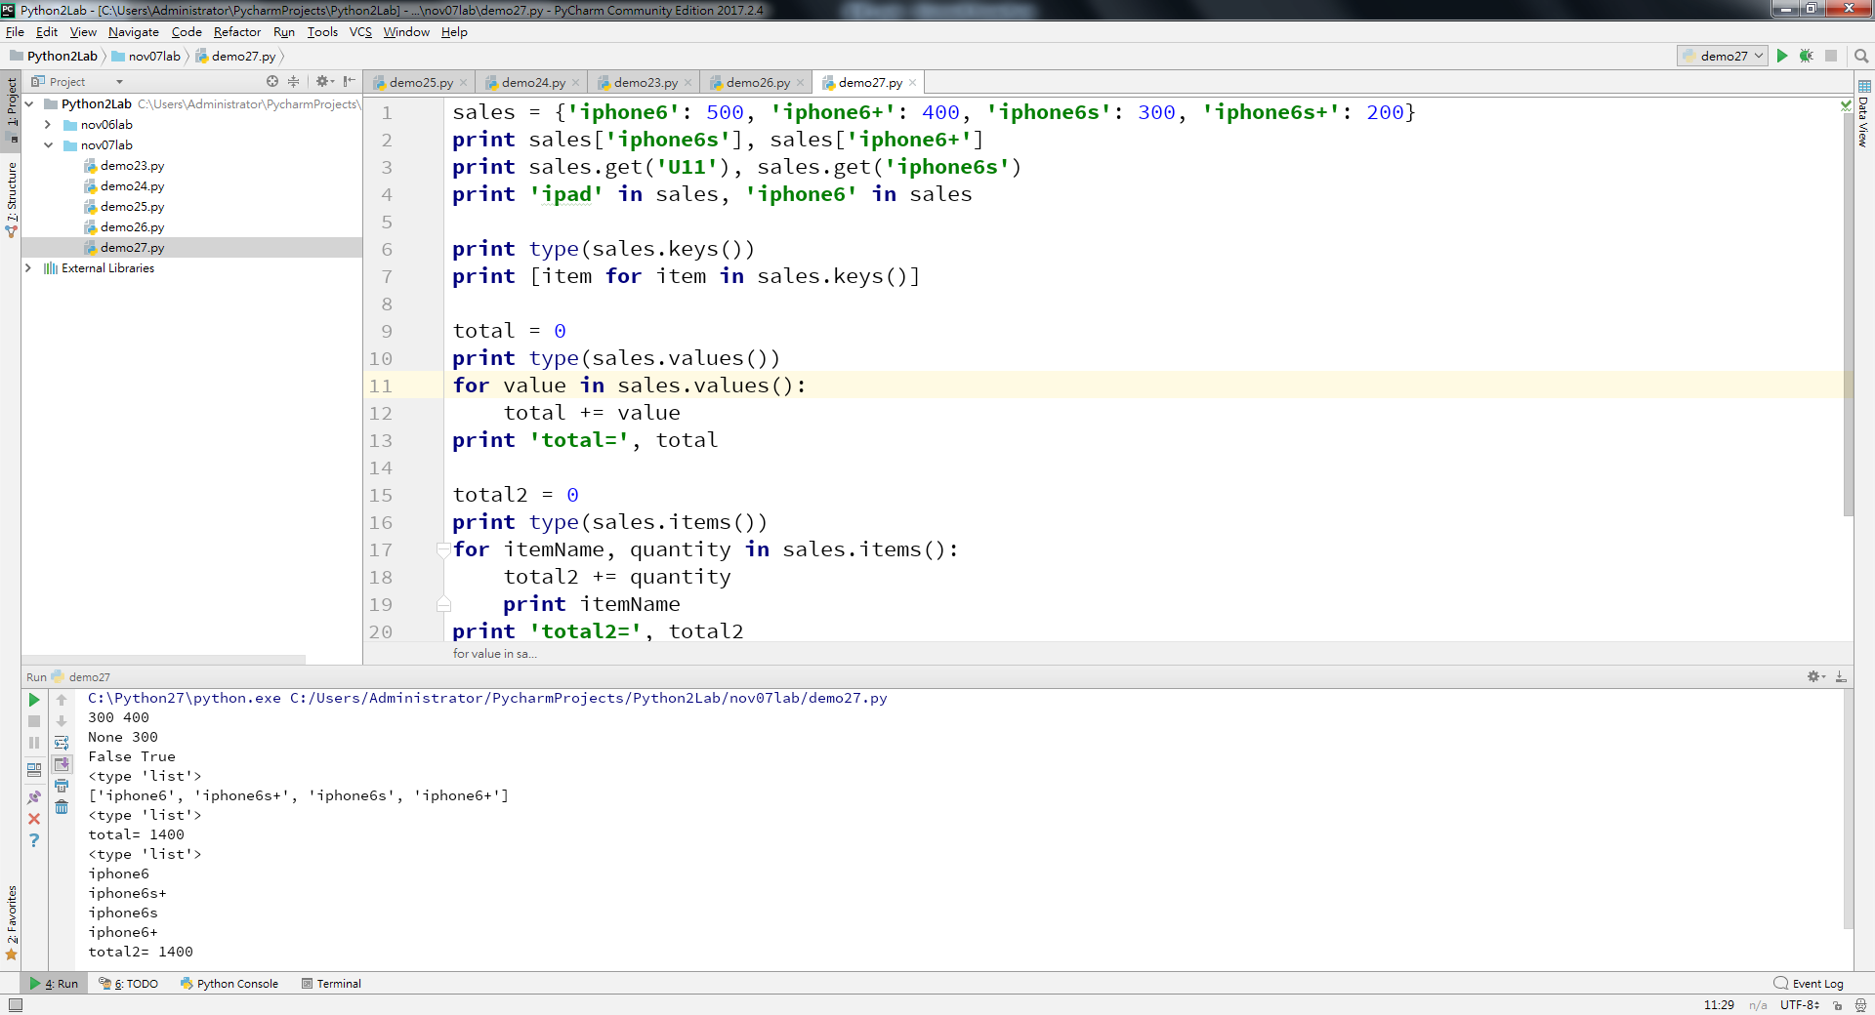
py2
Notes:
sales = {'iphone6': 500, 'iphone6+': 400, 'iphone6s': 300, 'iphone6s+': 200} print sales['iphone6s'], sales['iphone6+'] print sales.get('U11'), sales.get('iphone6s') print 'ipad' in sales, 'iphone6' in sales print type(sales.keys()) print [item for item in sales.keys()] total = 0 print type(sales.values()) for value in sales.values(): total += value print 'total=', total total2 = 0 print type(sales.items()) for itemName, quantity in sales.items(): total2 += quantity print itemName print 'total2=', total2

Slide 24
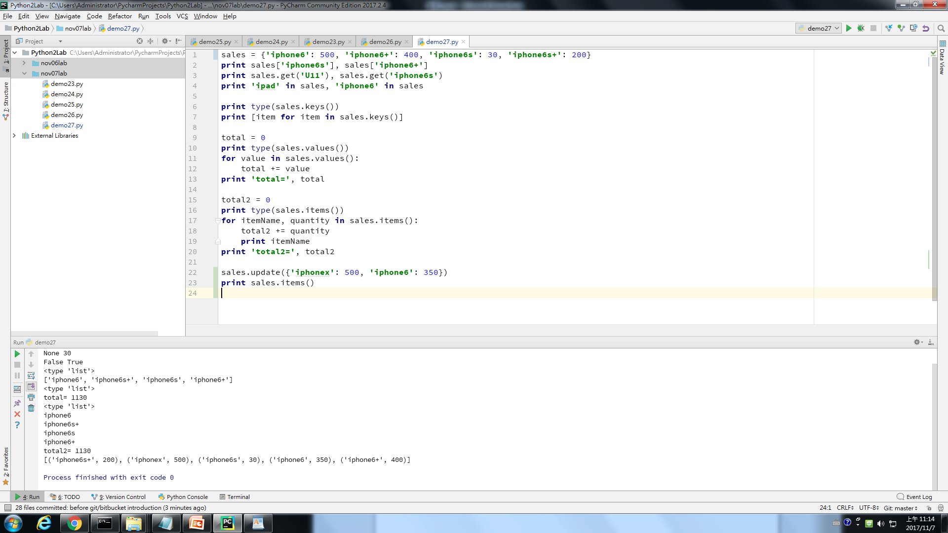
Notes:
sales = {'iphone6': 500, 'iphone6+': 400, 'iphone6s': 30, 'iphone6s+': 200} print sales['iphone6s'], sales['iphone6+'] print sales.get('U11'), sales.get('iphone6s') print 'ipad' in sales, 'iphone6' in sales print type(sales.keys()) print [item for item in sales.keys()] total = 0 print type(sales.values()) for value in sales.values(): total += value print 'total=', total total2 = 0 print type(sales.items()) for itemName, quantity in sales.items(): total2 += quantity print itemName print 'total2=', total2 sales.update({'iphonex':500,'iphone6':350}) print sales.items()

Slide 25
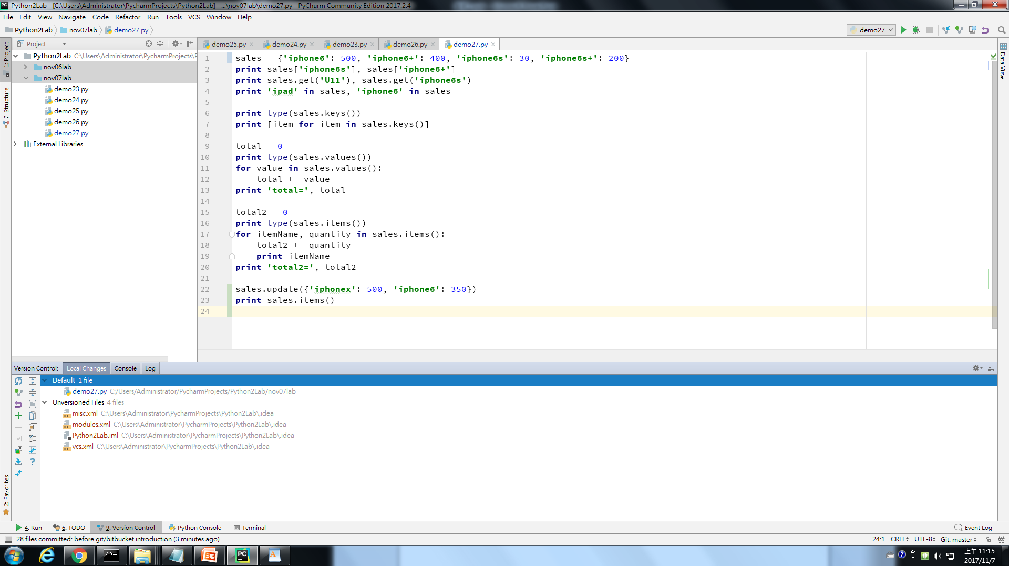

Slide 27
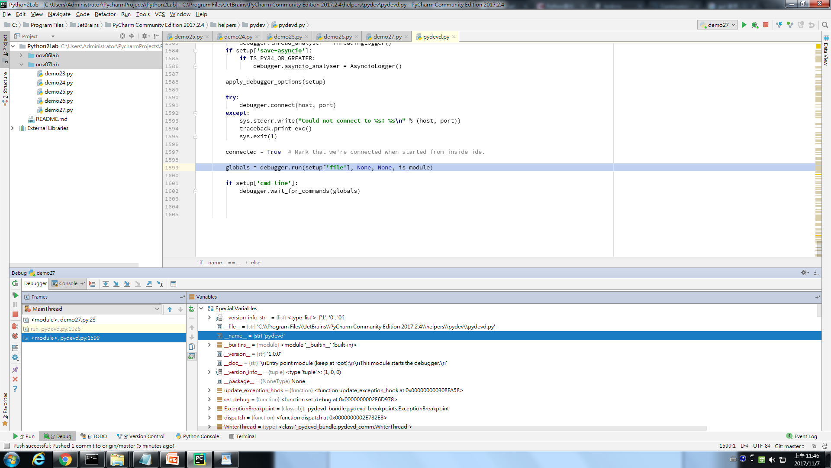

Slide 28
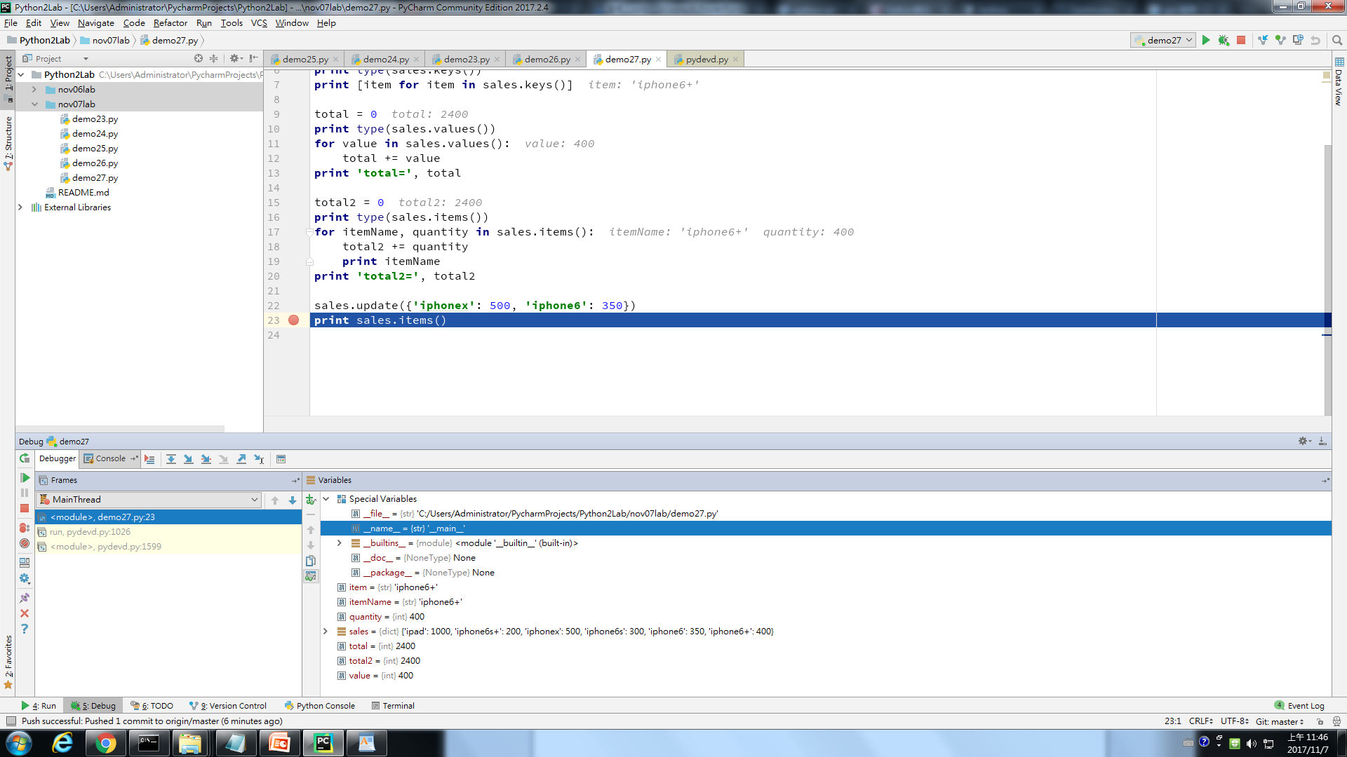

Slide 29
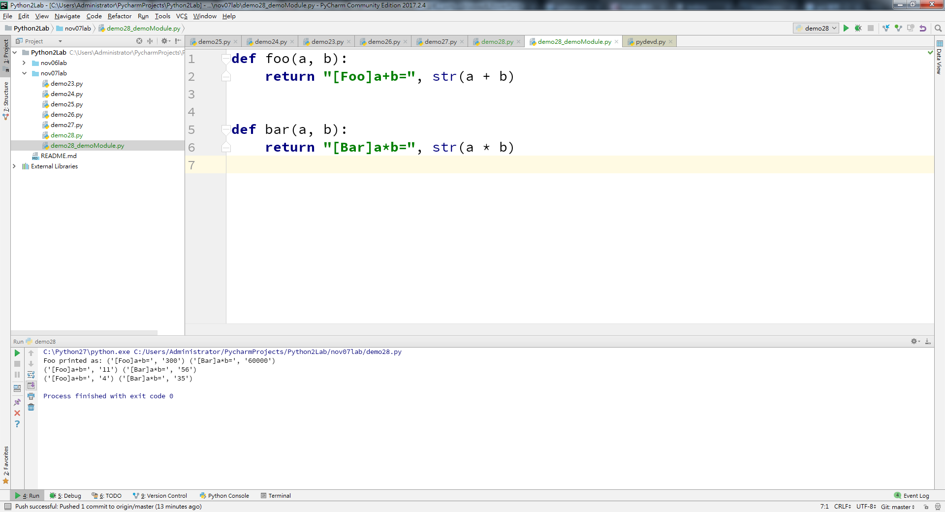
py2
Notes:
def foo(a,b): return "[Foo]a+b=",str(a+b) def bar(a,b): return "[Bar]a*b=",str(a*b)

Slide 30
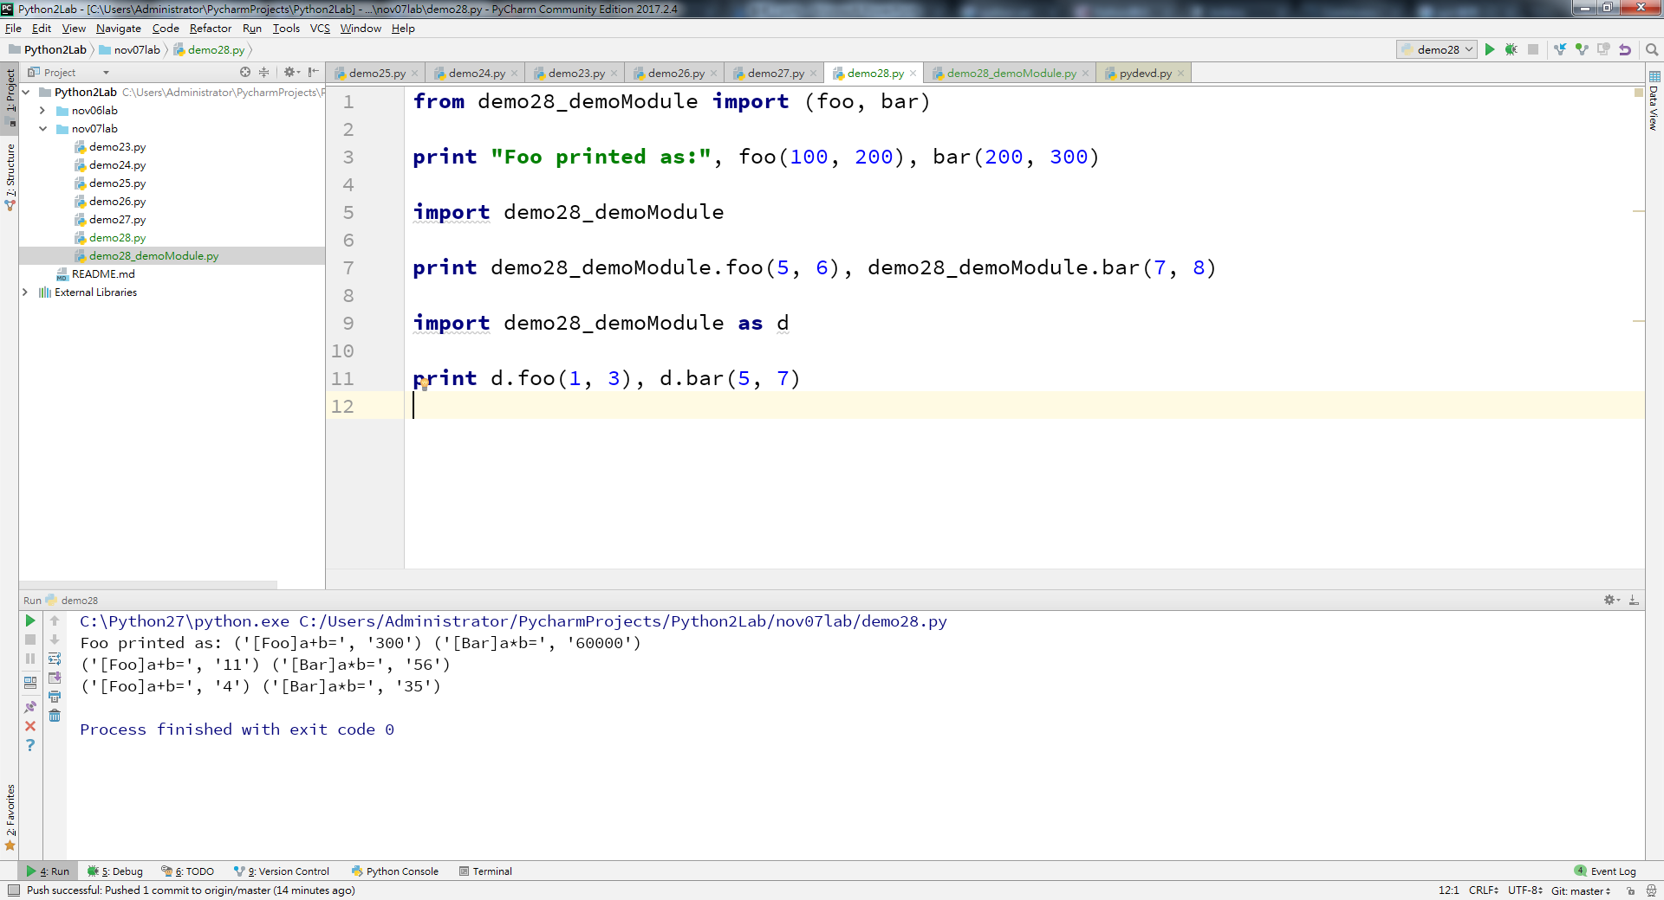
py2
Notes:
from demo28_demoModule import (foo, bar) print "Foo printed as:", foo(100, 200), bar(200, 300) import demo28_demoModule print demo28_demoModule.foo(5, 6), demo28_demoModule.bar(7, 8) import demo28_demoModule as d print d.foo(1, 3), d.bar(5, 7)

Slide 31
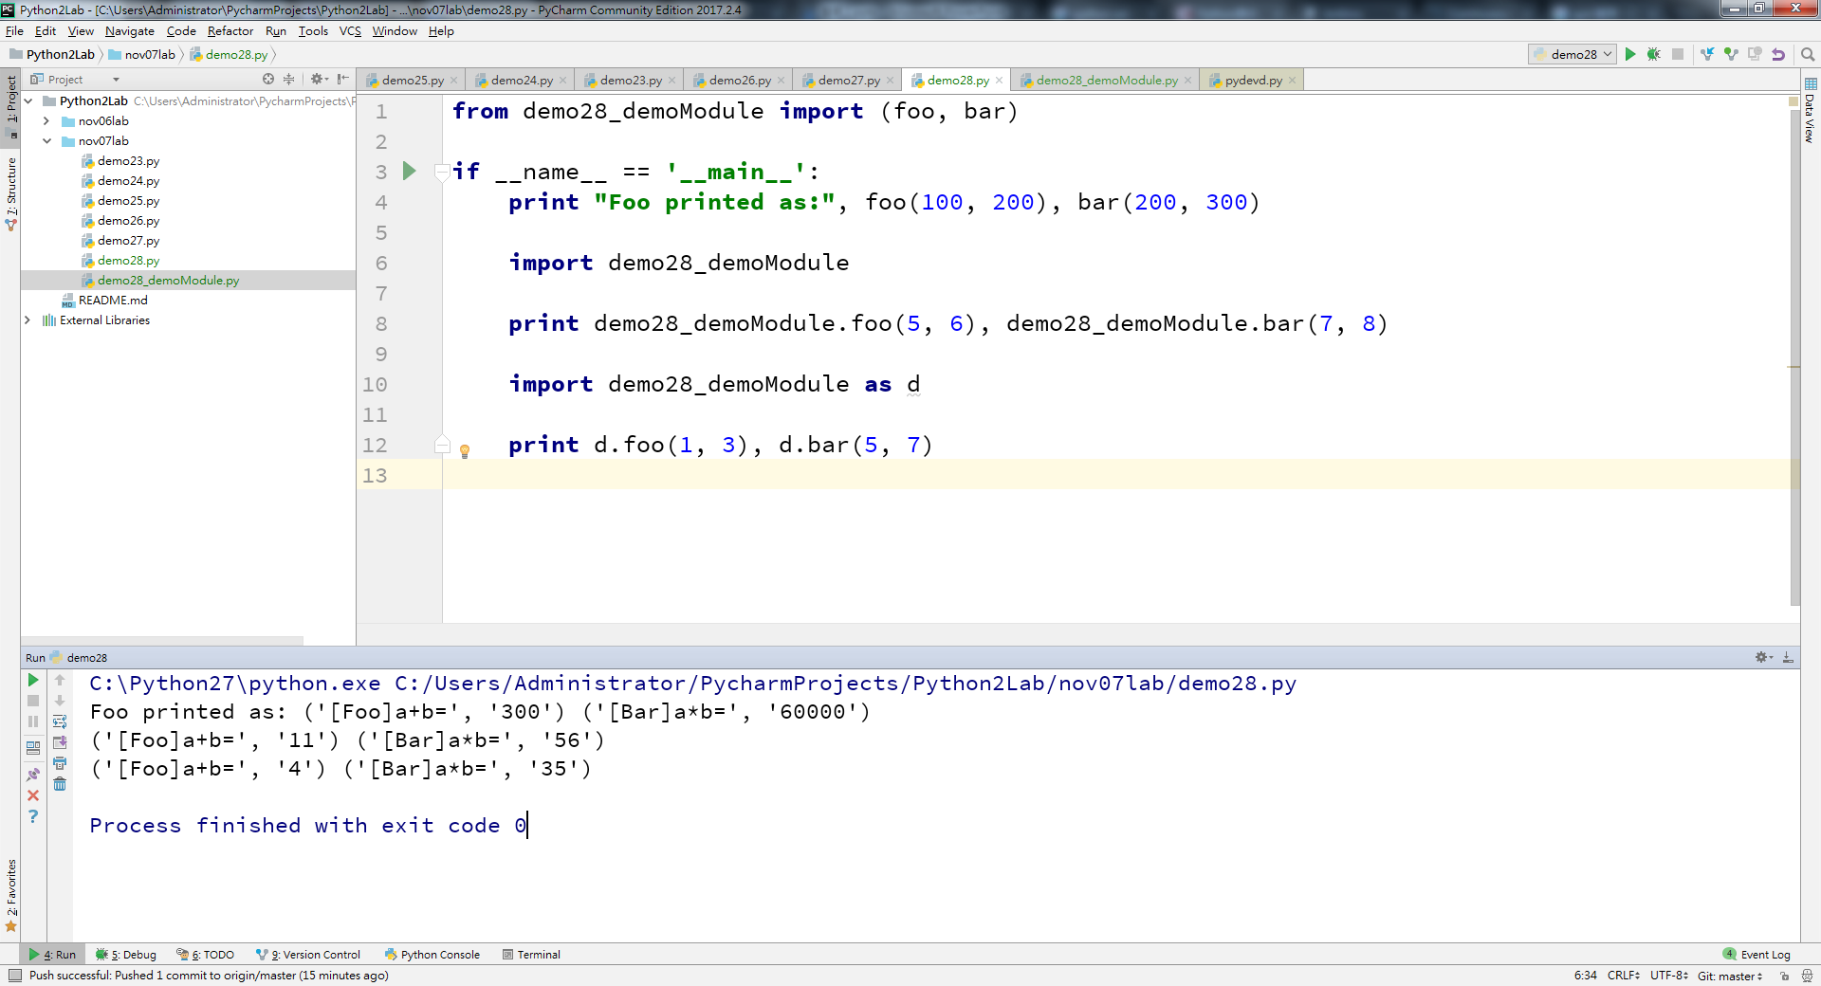
py2

Slide 32
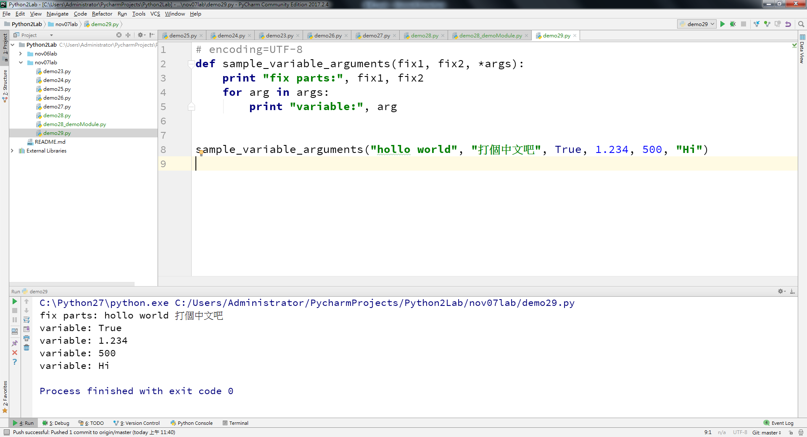
py2
Notes:
# encoding=UTF-8 def sample_variable_arguments(fix1, fix2, *args): print "fix parts:", fix1, fix2 for arg in args: print "variable:", arg sample_variable_arguments("hollo world", "打個中文吧", True, 1.234, 500, "Hi")

Slide 33
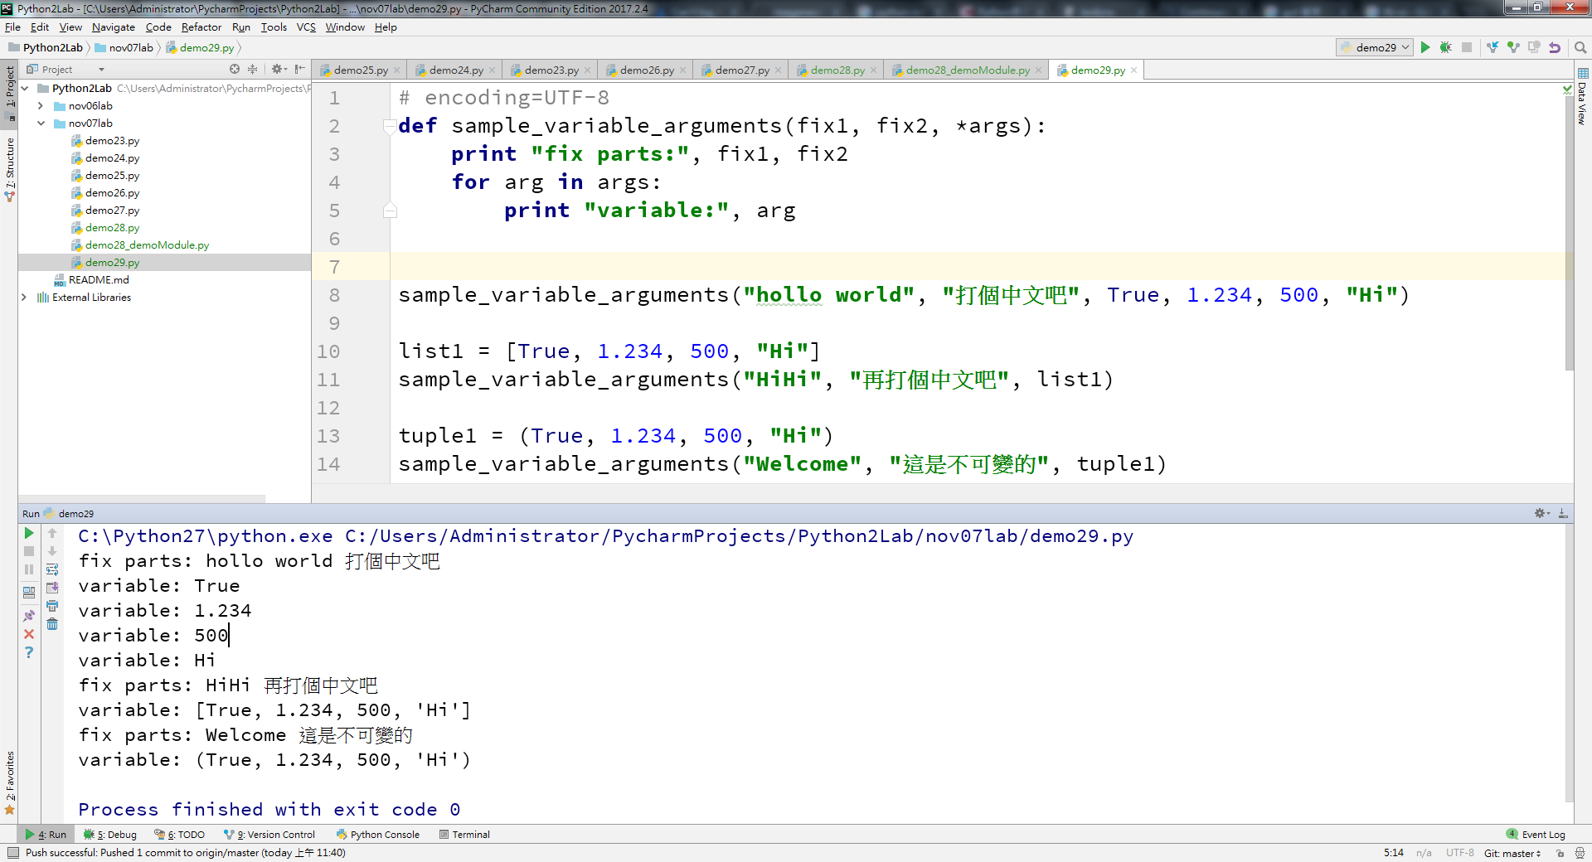
py2
Notes:
# encoding=UTF-8 def sample_variable_arguments(fix1, fix2, *args): print "fix parts:", fix1, fix2 for arg in args: print "variable:", arg sample_variable_arguments("hollo world", "打個中文吧", True, 1.234, 500, "Hi") list1 = [True, 1.234, 500, "Hi"] sample_variable_arguments("HiHi", "再打個中文吧", list1) tuple1 = (True, 1.234, 500, "Hi") sample_variable_arguments("Welcome", "這是不可變的", tuple1)

Slide 34
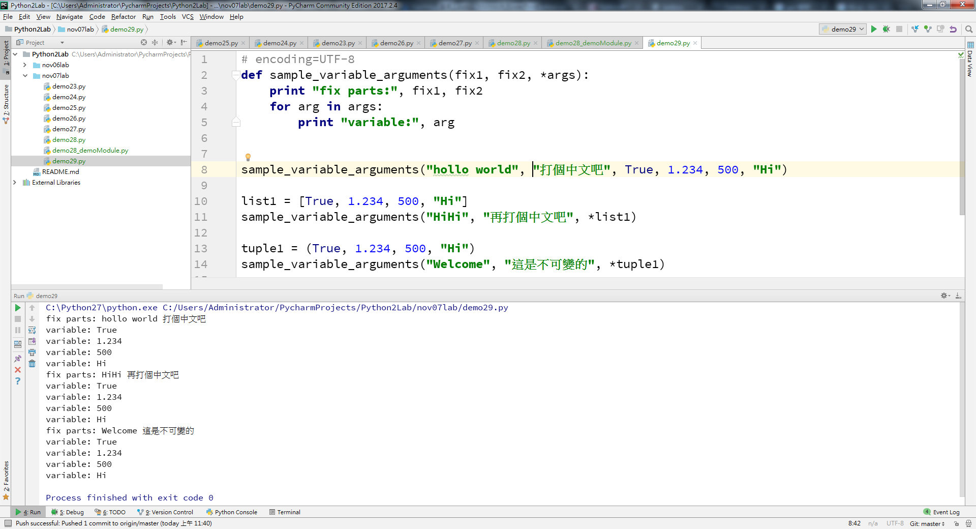
py2
Notes:
# encoding=UTF-8 def sample_variable_arguments(fix1, fix2, *args): print "fix parts:", fix1, fix2 for arg in args: print "variable:", arg sample_variable_arguments("hollo world", "打個中文吧", True, 1.234, 500, "Hi") list1 = [True, 1.234, 500, "Hi"] sample_variable_arguments("HiHi", "再打個中文吧", *list1) tuple1 = (True, 1.234, 500, "Hi") sample_variable_arguments("Welcome", "這是不可變的", *tuple1)

Slide 35
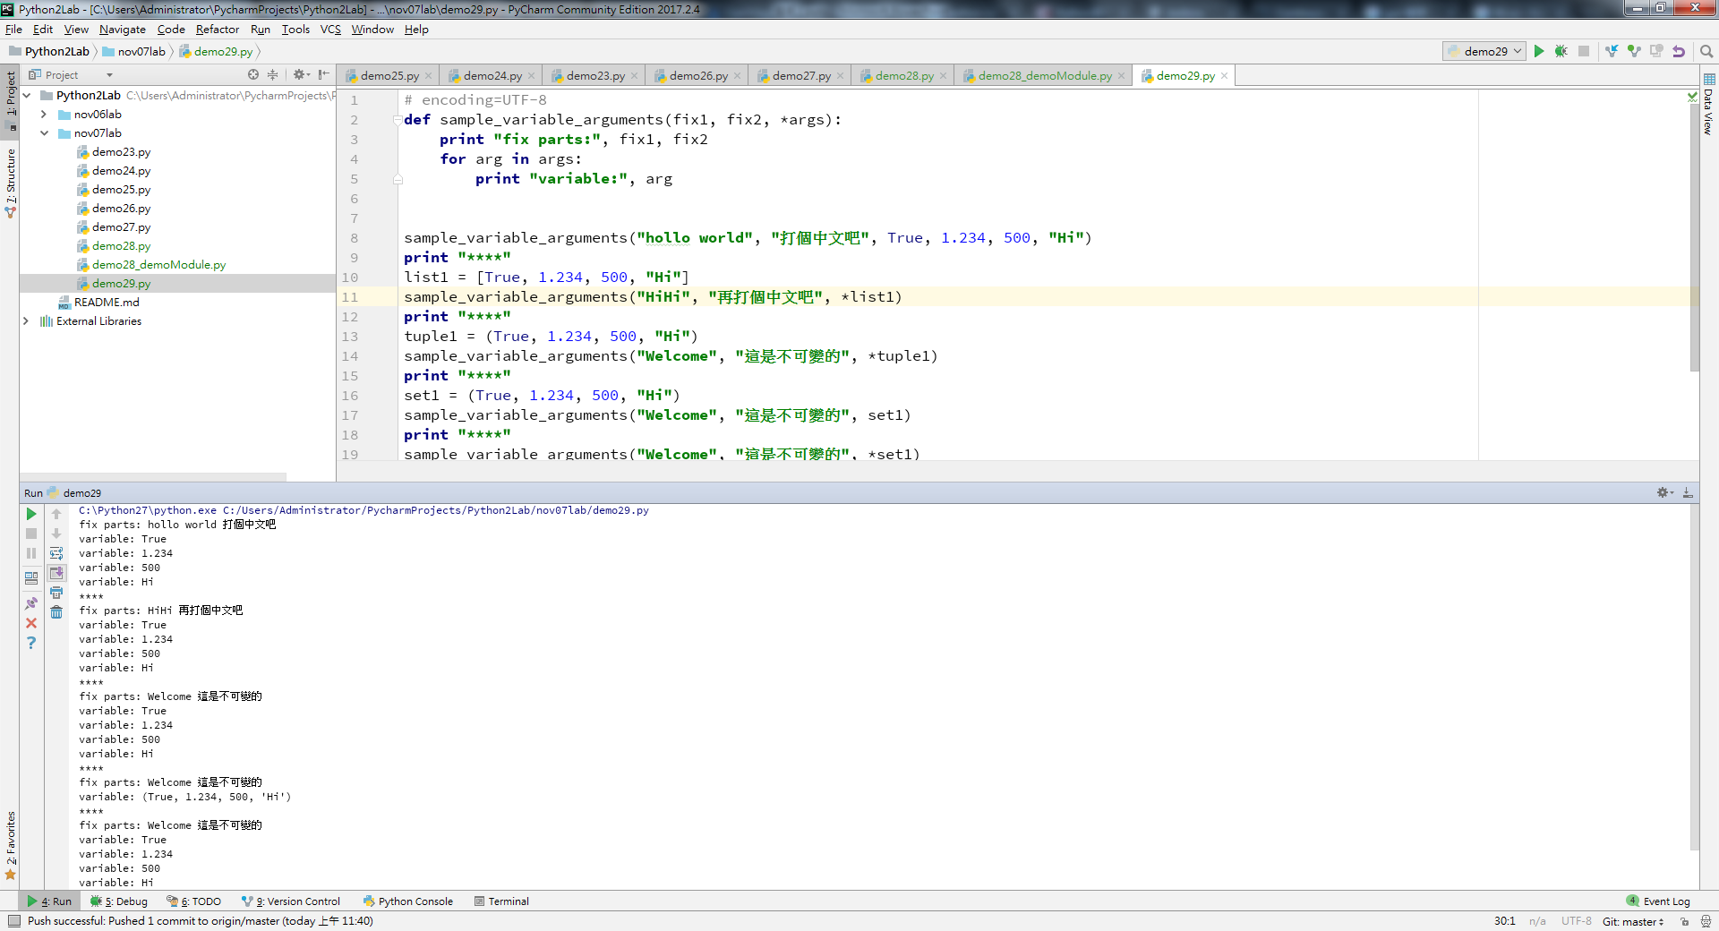
py2
Notes:
# encoding=UTF-8 def sample_variable_arguments(fix1, fix2, *args): print "fix parts:", fix1, fix2 for arg in args: print "variable:", arg sample_variable_arguments("hollo world", "打個中文吧", True, 1.234, 500, "Hi") print "****" list1 = [True, 1.234, 500, "Hi"] sample_variable_arguments("HiHi", "再打個中文吧", *list1) print "****" tuple1 = (True, 1.234, 500, "Hi") sample_variable_arguments("Welcome", "這是不可變的", *tuple1) print "****" set1 = (True, 1.234, 500, "Hi") sample_variable_arguments("Welcome", "這是不可變的", set1) print "****" sample_variable_arguments("Welcome", "這是不可變的", *set1)

Slide 36
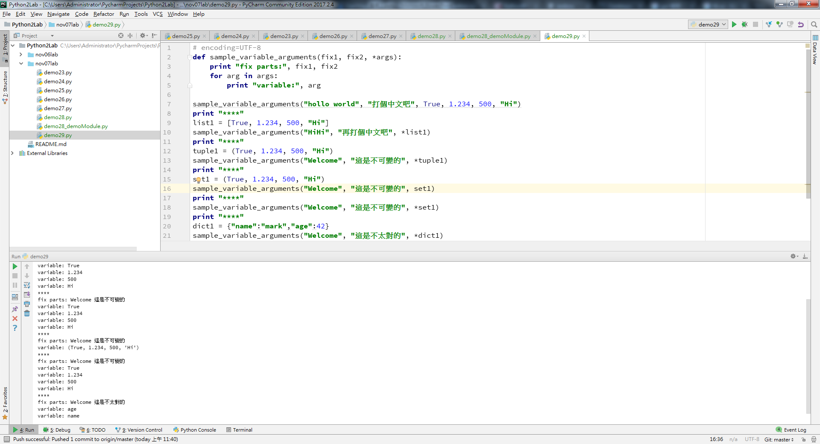
py2
Notes:
# encoding=UTF-8 def sample_variable_arguments(fix1, fix2, *args): print "fix parts:", fix1, fix2 for arg in args: print "variable:", arg sample_variable_arguments("hollo world", "打個中文吧", True, 1.234, 500, "Hi") print "****" list1 = [True, 1.234, 500, "Hi"] sample_variable_arguments("HiHi", "再打個中文吧", *list1) print "****" tuple1 = (True, 1.234, 500, "Hi") sample_variable_arguments("Welcome", "這是不可變的", *tuple1) print "****" set1 = (True, 1.234, 500, "Hi") sample_variable_arguments("Welcome", "這是不可變的", set1) print "****" sample_variable_arguments("Welcome", "這是不可變的", *set1) print "****" dict1 = {"name":"mark","age":42} sample_variable_arguments("Welcome", "這是不太對的", *dict1)

Slide 37
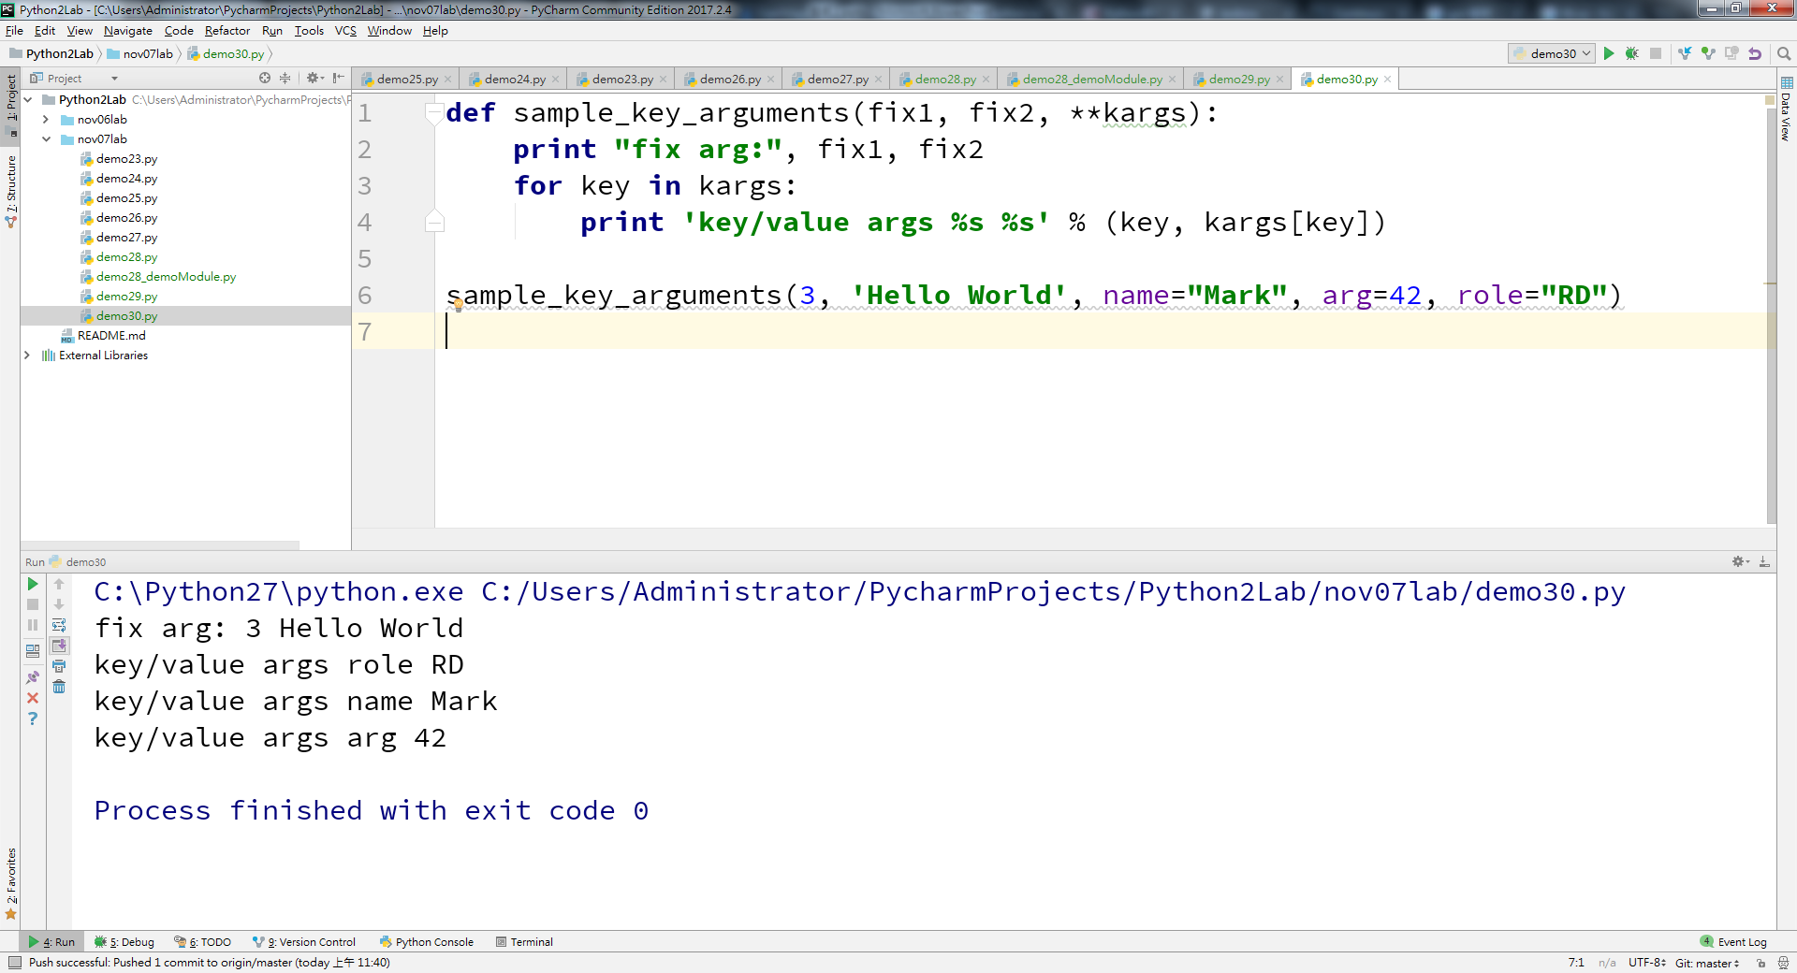
py2
Notes:
def sample_key_arguments(fix1, fix2, **kargs): print "fix arg:", fix1, fix2 for key in kargs: print 'key/value args %s %s' % (key, kargs[key]) sample_key_arguments(3, 'Hello World', name="Mark", arg=42, role="RD")

Slide 38
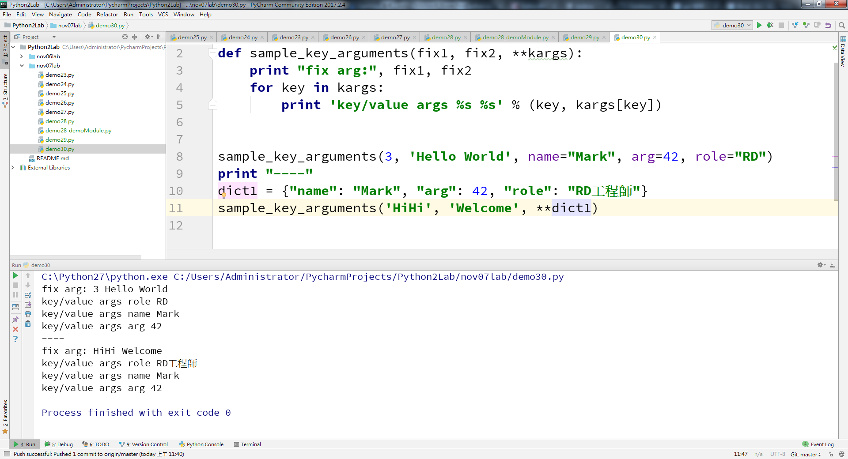
py2
Notes:
# encoding=UTF-8 def sample_key_arguments(fix1, fix2, **kargs): print "fix arg:", fix1, fix2 for key in kargs: print 'key/value args %s %s' % (key, kargs[key]) sample_key_arguments(3, 'Hello World', name="Mark", arg=42, role="RD") print "----" dict1 = {"name": "Mark", "arg": 42, "role": "RD工程師"} sample_key_arguments('HiHi', 'Welcome', **dict1)

Slide 39
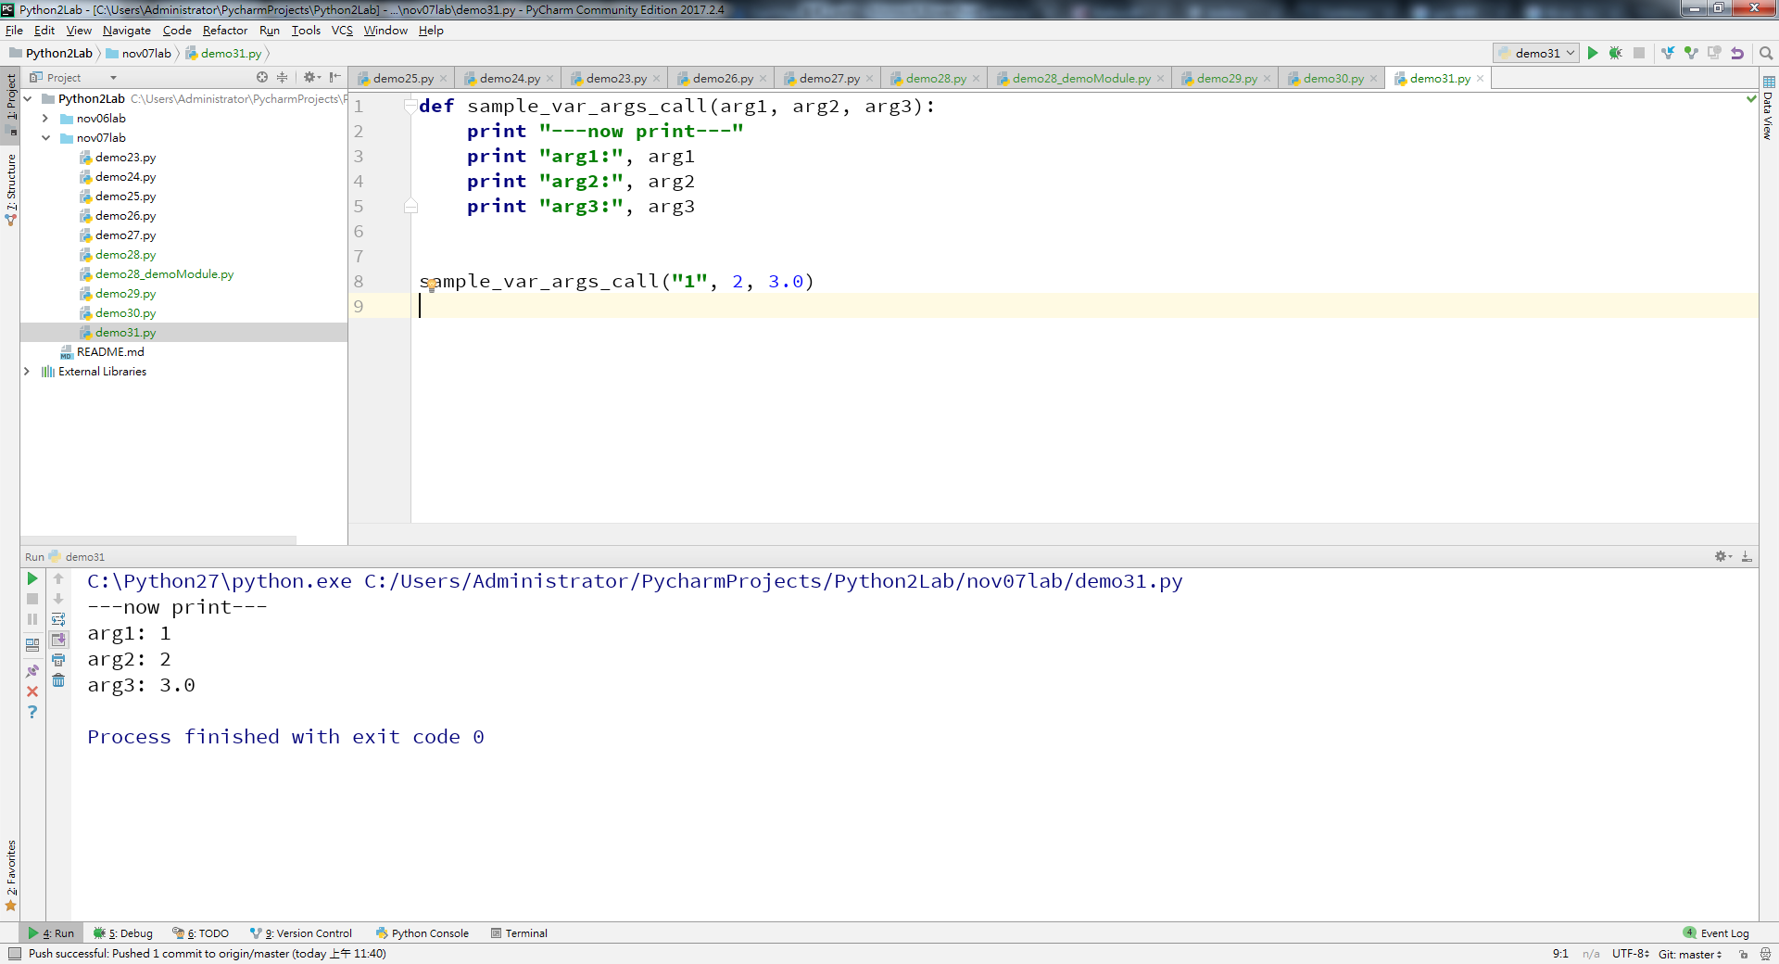
py2

Slide 40
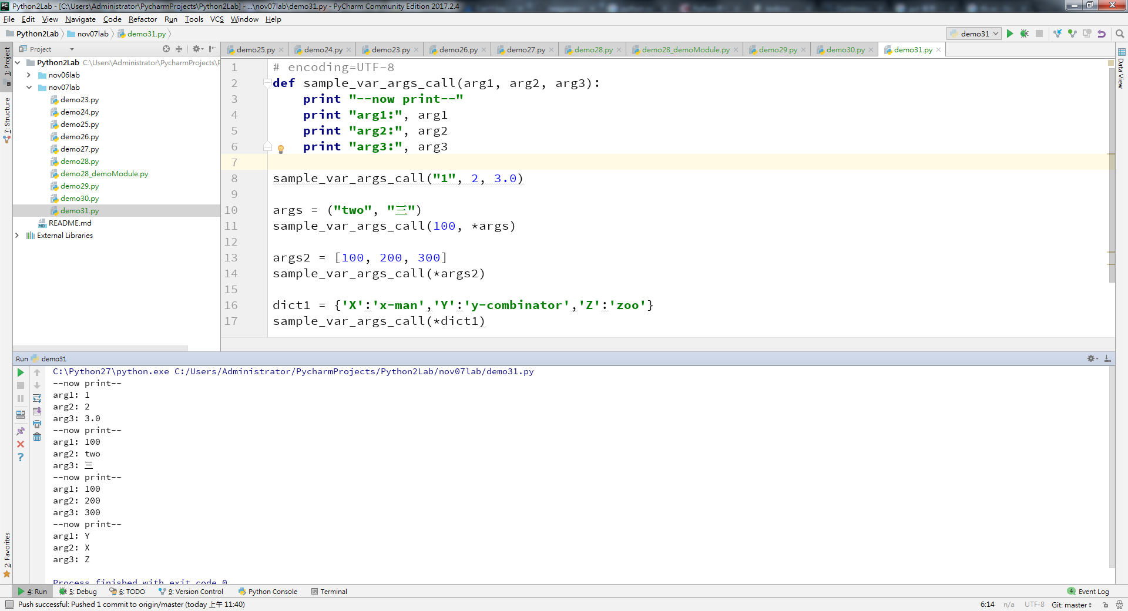
py2
Notes:
# encoding=UTF-8 def sample_var_args_call(arg1, arg2, arg3): print "--now print--" print "arg1:", arg1 print "arg2:", arg2 print "arg3:", arg3 sample_var_args_call("1", 2, 3.0) args = ("two", "三") sample_var_args_call(100, *args) args2 = [100, 200, 300] sample_var_args_call(*args2) dict1 = {'X':'x-man','Y':'y-combinator','Z':'zoo'} sample_var_args_call(*dict1)

Slide 41
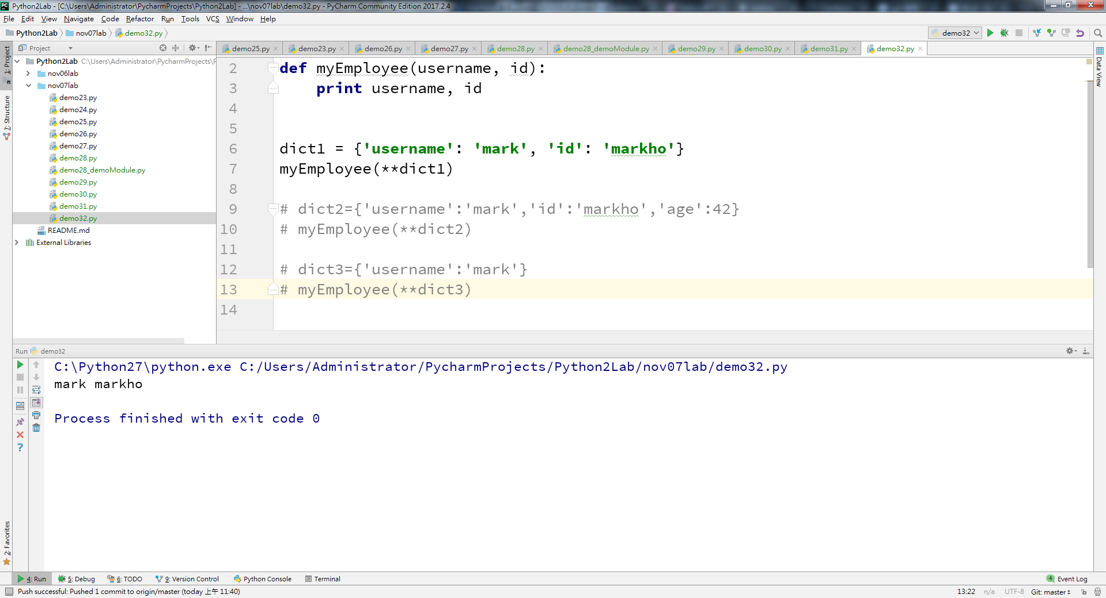
py2
Notes:
# encoding=UTF-8 def myEmployee(username, id): print username, id dict1 = {'username': 'mark', 'id': 'markho'} myEmployee(**dict1) # dict2={'username':'mark','id':'markho','age':42} # myEmployee(**dict2) # dict3={'username':'mark'} # myEmployee(**dict3)

Slide 42
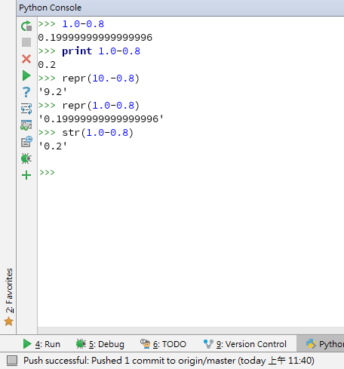
py2

Slide 43
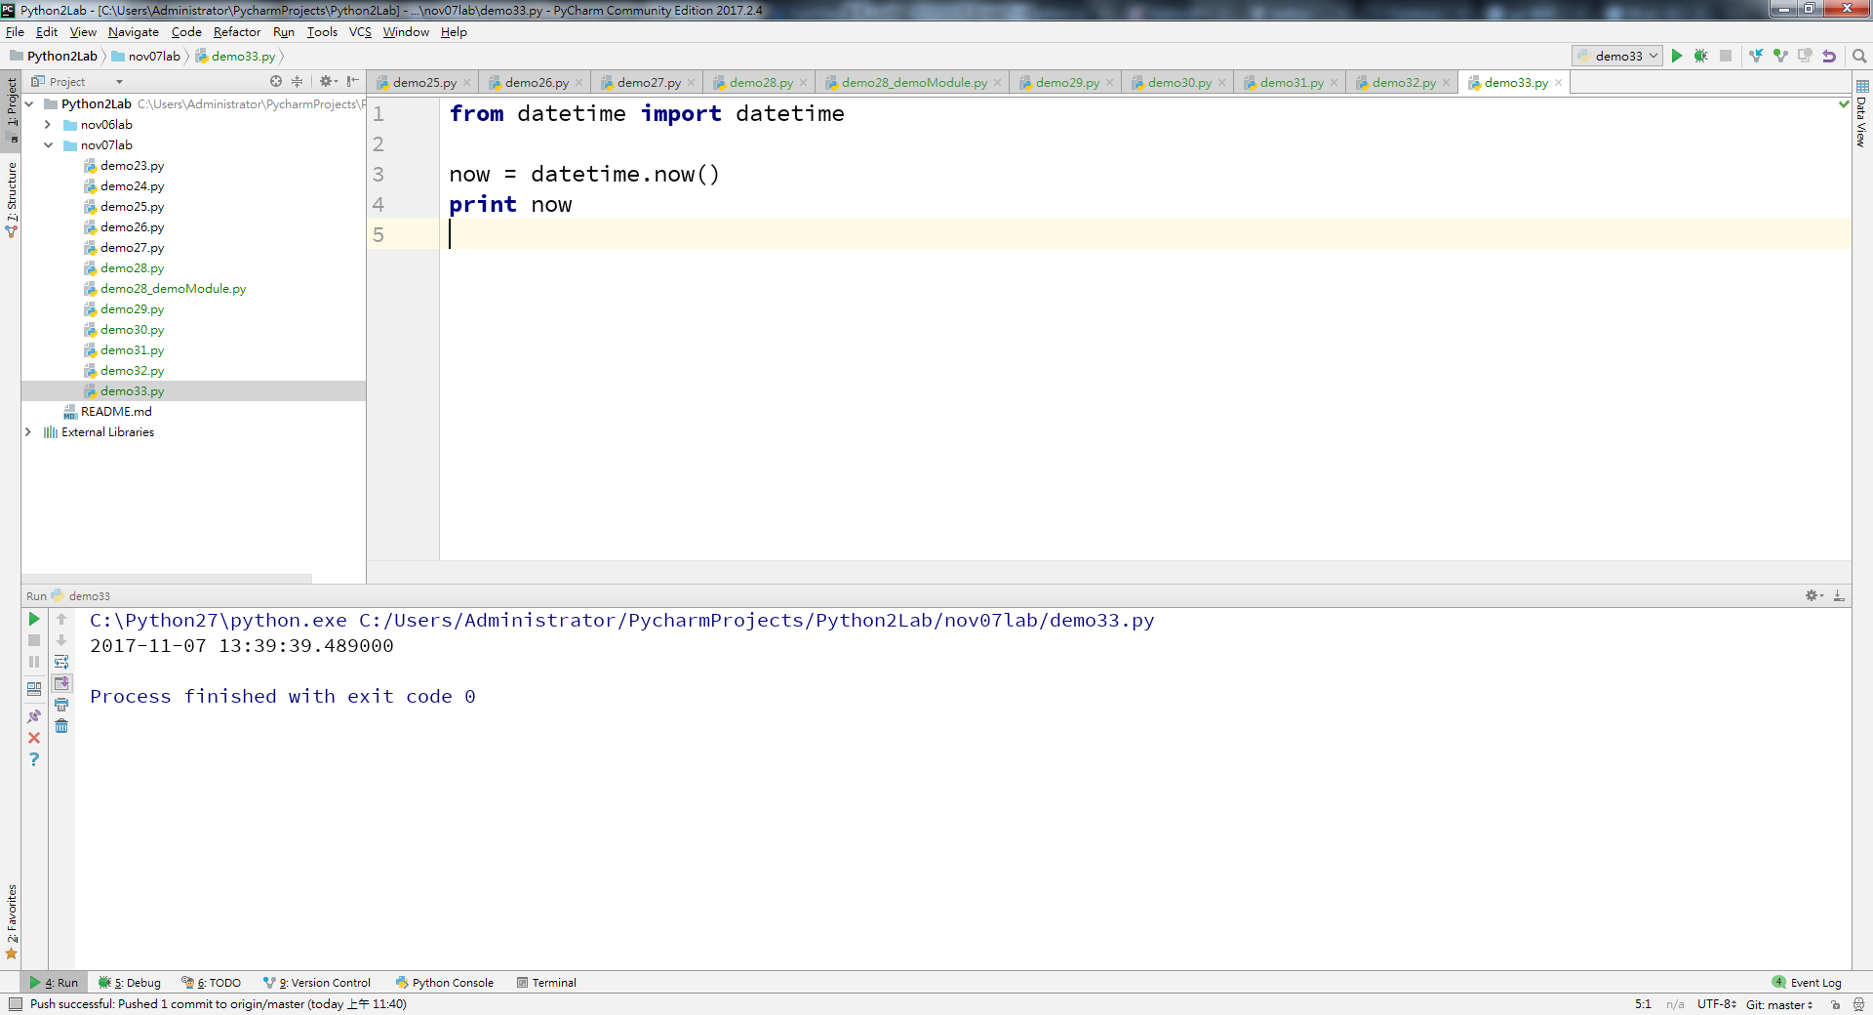
py2
Notes:
from datetime import datetime now = datetime.now() print now

Slide 44
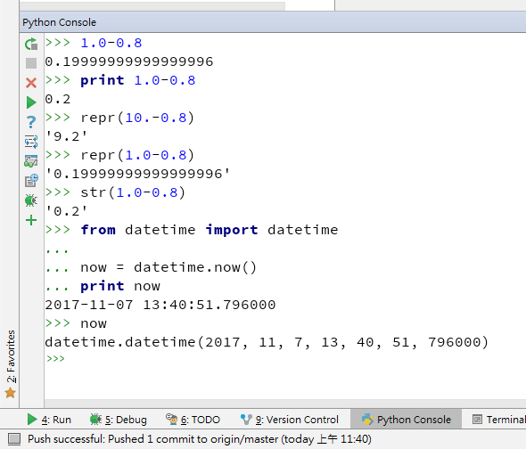
py2

Slide 45
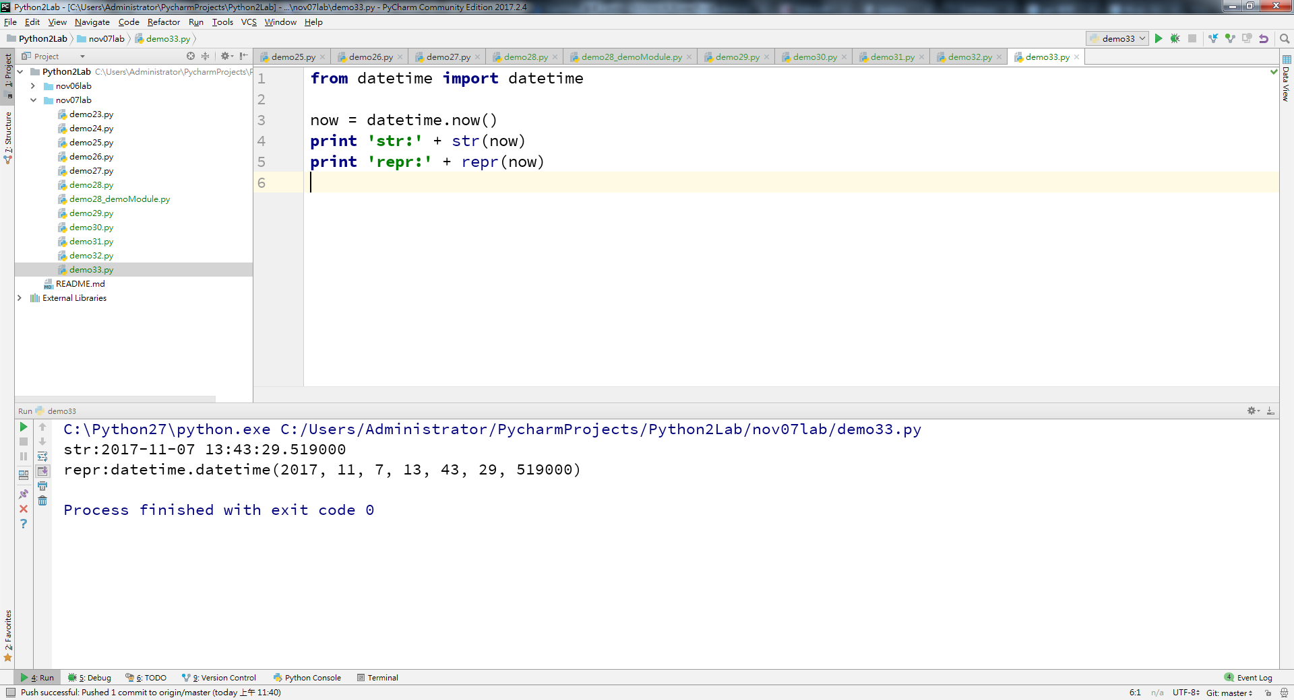
py2

Slide 46
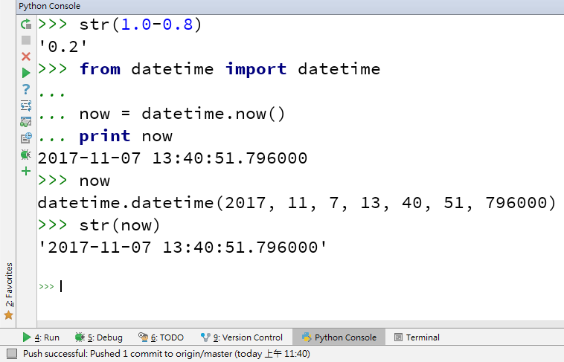
py2

Slide 47
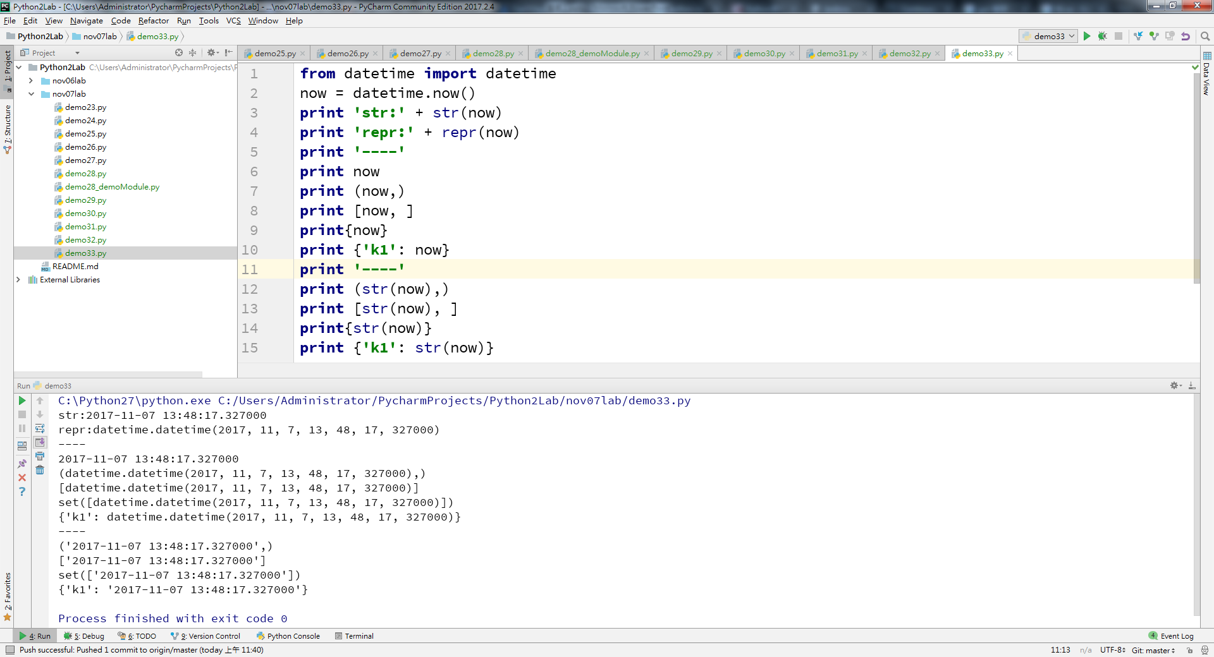
py2

Slide 48
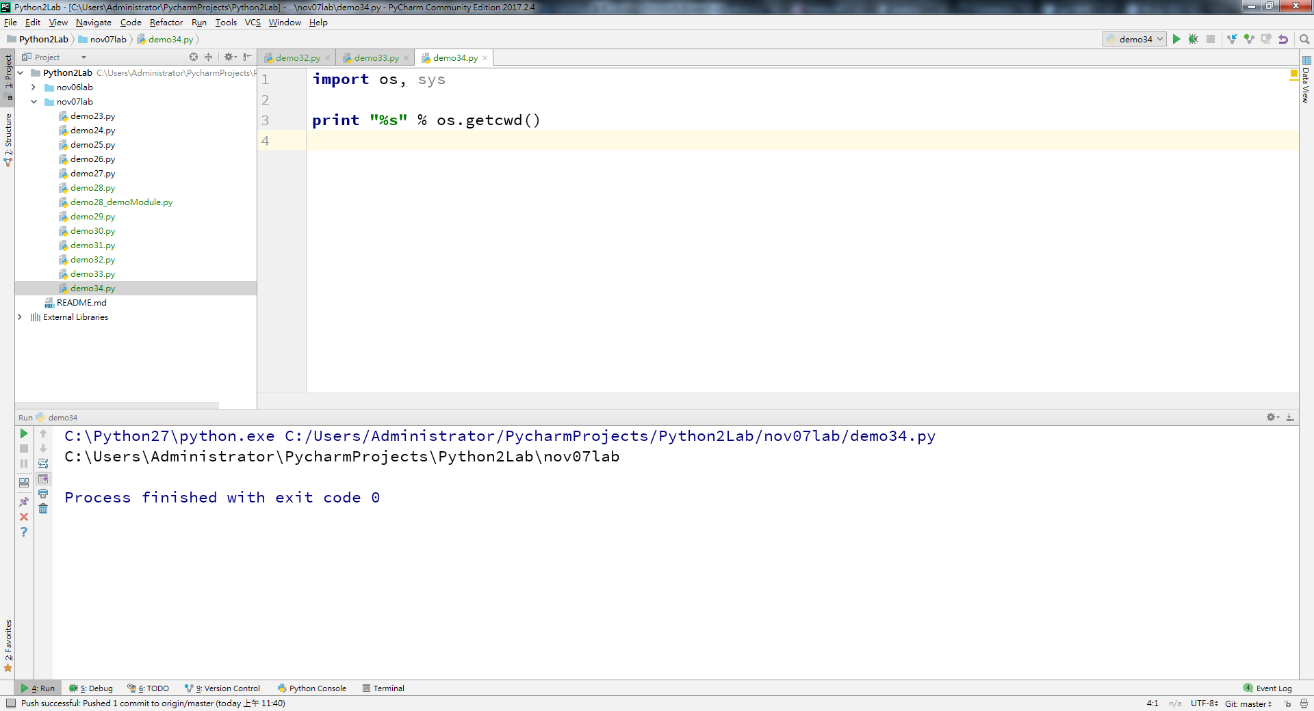
py2
Notes:
import os, sys print "%s" % os.getcwd()

Slide 49
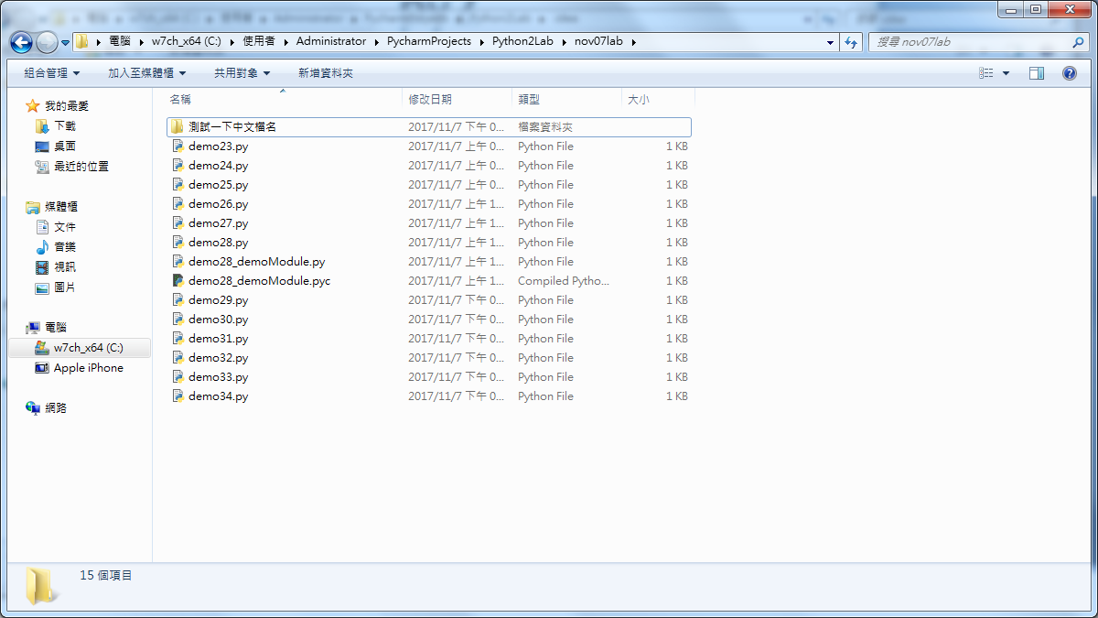
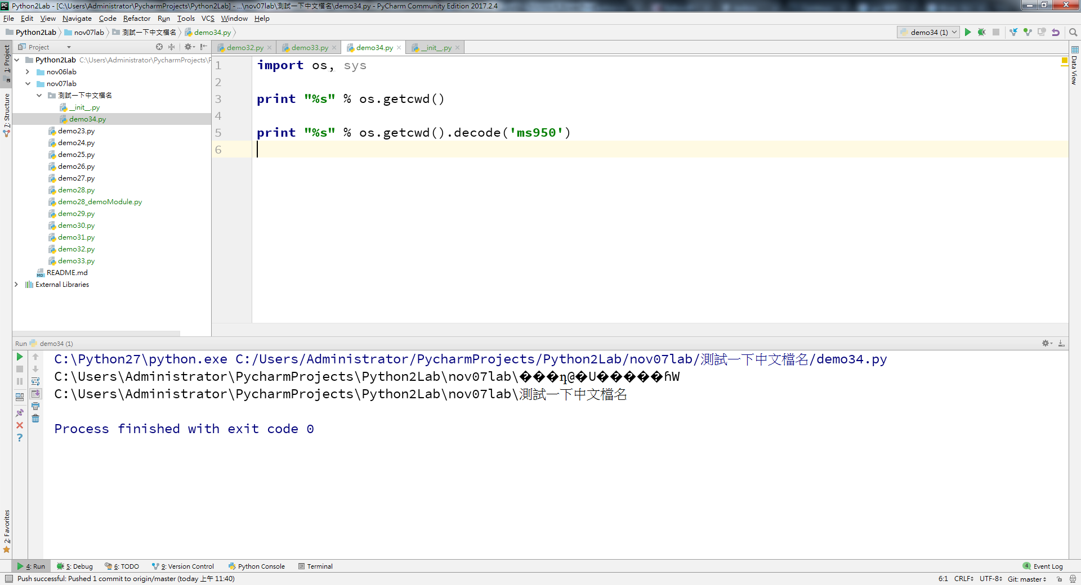
py2
Notes:
import os, sys print "%s" % os.getcwd() print "%s" % os.getcwd().decode('ms950')

Slide 50
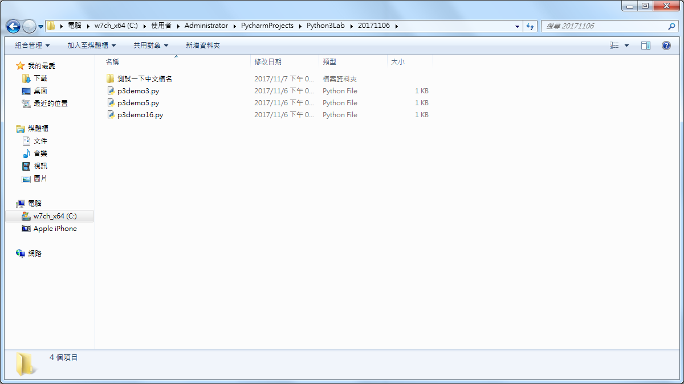
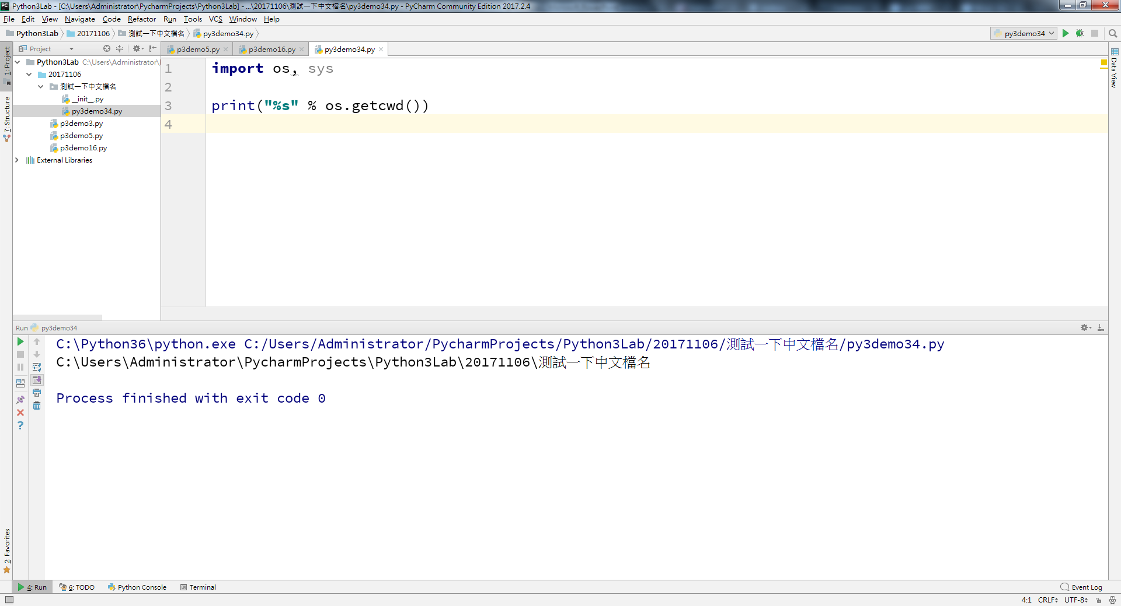
py3
Notes:
import os, sys print("%s" % os.getcwd())

Slide 51


py2x

Slide 52


py3x
Notes:
import os, sys print("%s" % os.getcwd()) os.mkdir('foo目錄') os.chdir('foo目錄') print("%s" % os.getcwd()) os.chdir("..") os.rmdir('foo目錄')

Slide 54

py2

Slide 55

py2

Slide 56

py3

Slide 57

py2

Slide 58

py2

Slide 59

py2

Slide 60

py2

Slide 61

py2

Slide 62

py2
Notes:
# encoding=UTF-8 import itertools result = itertools.chain("abc", '123', u'甲乙丙丁') print type(result), result for item in result: print item

Slide 63

py2 迭代的跑過一次,再跑第二次會跑不出來!

Slide 64

py2

Slide 65

py2
Notes:
# encoding=UTF-8 import itertools result = itertools.chain("abc", '123', u'甲乙丙丁') print type(result), result for item in result: print item print 'print again' # 迭代的跑過一次,再跑第二次會跑不出來! for item in result: print item result2 = itertools.combinations('ABCDE', 2) for item in result2: print item print 'print combinations again' for item in result2: print item

Slide 66

py2
Notes:
# encoding=UTF-8 import itertools result = itertools.chain("abc", '123', u'甲乙丙丁') print type(result), result for item in result: print item print 'print again' # 迭代的跑過一次,再跑第二次會跑不出來! for item in result: print item result2 = itertools.combinations('ABCDE', 2) for item in result2: print item print 'print combinations again' for item in result2: print item per1 = itertools.permutations('ABCD', 2) result3 = [item for item in per1] print len(result3) for item in result3: print len(item), print [item for item in result3]

Slide 67

py2
Notes:
# encoding=UTF-8 import itertools result = itertools.chain("abc", '123', u'甲乙丙丁') print type(result), result for item in result: print item print 'print again' # 迭代的跑過一次,再跑第二次會跑不出來! for item in result: print item result2 = itertools.combinations('ABCDE', 2) for item in result2: print item print 'print combinations again' for item in result2: print item per1 = itertools.permutations('ABCD', 2) result3 = [item for item in per1] print result3 print type(result3) print '----' print len(result3) for item in result3: print len(item), print [item for item in result3]

Slide 68

Py2x demo36

Slide 69

py2

Slide 70

py2
Notes:
# encoding=UTF-8 import json data1 = {'name': 'mark何', 'age': 42, 'weight': 73.5} jsonString1 = json.dumps(data1) print jsonString1 print type(jsonString1) dict1 = json.loads(jsonString1) for k, v in dict1.items(): print k, v

Slide 71

py2

Slide 72

py2
Notes:
# encoding=UTF-8 import json data1 = {'name': 'mark何', 'age': 42, 'weight': 73.5} jsonString1 = json.dumps(data1) print jsonString1 print type(jsonString1) dict1 = json.loads(jsonString1) for k, v in dict1.items(): print k, v data2 = ["Sun", "Mon", u'周二', u'水曜日'] jsonString2 = json.dumps(data2, encoding='utf-8') print jsonString2 print json.loads(jsonString2)[0], json.loads(jsonString2)[1], json.loads(jsonString2)[2]

Slide 73

py2
Notes:
# encoding=UTF-8 import json data1 = {'name': 'mark何', 'age': 42, 'weight': 73.5} jsonString1 = json.dumps(data1) print jsonString1 print type(jsonString1) dict1 = json.loads(jsonString1) for k, v in dict1.items(): print k, v data2 = ["Sun", "Mon", u'周二', u'水曜日'] print type(data2) jsonString2 = json.dumps(data2, encoding='utf-8') print jsonString2 print json.loads(jsonString2)[0], json.loads(jsonString2)[1], json.loads(jsonString2)[2]

Slide 75

https://bugzilla.mozilla.org/rest/bug/35

Slide 76

py2
Notes:
import requests url = "https://bugzilla.mozilla.org/rest/bug/35" response1 = requests.get(url) print response1.status_code, response1.headers['content-type']

Slide 77

py2
Notes:
import requests url = "https://bugzilla.mozilla.org/rest/bug/35" response1 = requests.get(url) print response1.status_code, response1.headers['content-type'] print type(response1.json()) for k, v in response1.json().items(): print k print v

Slide 78

py2
Notes:
import requests url = "https://bugzilla.mozilla.org/rest/bug/35" response1 = requests.get(url) print response1.status_code, response1.headers['content-type'] print type(response1.json()) for k, v in response1.json().items(): print k print v for bug in response1.json()['bugs']: print bug

Slide 79

py2
Notes:
import requests url = "https://bugzilla.mozilla.org/rest/bug/35" response1 = requests.get(url) print response1.status_code, response1.headers['content-type'] print type(response1.json()) for k, v in response1.json().items(): print k print v for bug in response1.json()['bugs']: print bug for email in response1.json()['bugs'][0]['cc']: print email

Slide 80

py2
Notes:
from bs4 import BeautifulSoup import requests url = "https://www.uuu.com.tw/" reponse1 = requests.get(url) soup = BeautifulSoup(reponse1.content, 'html.parser') hotTopices = soup.find('div', {'id': 'hot'}) items = hotTopices.find_all('a') for item in items: print item

Slide 81

py2
Notes:
from bs4 import BeautifulSoup import requests url = "https://www.uuu.com.tw/" reponse1 = requests.get(url) soup = BeautifulSoup(reponse1.content, 'html.parser') print soup.title.name hotTopices = soup.find('div', {'id': 'hot'}) items = hotTopices.find_all('a') for item in items: print item.get_text() for item in items: print item.get('href')

Slide 82

py2
Notes:
from bs4 import BeautifulSoup import requests url1 = "https://www.mobile01.com/" reponse1 = requests.get(url1) soup = BeautifulSoup(reponse1.content, 'html.parser') hot = soup.find('div', {'id': 'hot-posts'}) items = hot.find_all() for item in items: print item.get_text()

Slide 83

py2

Slide 84

py2

Slide 85

py2
Notes:
from bs4 import BeautifulSoup import requests url_list = ['https://www.mobile01.com/','https://www.mobile01.com/category.php?id=6'] for url in url_list: reponse1 = requests.get(url) soup = BeautifulSoup(reponse1.content, 'html.parser') print soup.title hot = soup.find('div', {'id': 'hot-posts'}) items = hot.find_all('a') for item in items: print item.get_text()

Slide 86

Notes:
pip install pillow

Slide 87

py2
Notes:
https://cache.movidius.com/images/made/images/remote/https_movidius-uploads.s3.amazonaws.com/1507675575-NCS_Aluminum_Web_1425_830_s_c1.jpg

Slide 88


py2
Notes:
from urllib2 import urlopen from PIL import Image import os url = 'https://cache.movidius.com/images/made/images/remote/https_movidius-uploads.s3.amazonaws.com/1507675575-NCS_Aluminum_Web_1425_830_s_c1.jpg' fileToSave = urlopen(url) image = Image.open(fileToSave) image.save('.\\images\\origin.jpg') half = (image.size[0] / 2, image.size[1] / 2) half_image = image.resize(half, Image.ANTIALIAS) half_image.save('.\\images\\small.jpg') rotation1 = image.transpose(Image.ROTATE_90) rotation1.save('.\\images\\r90.jpg') rotation2 = half_image.transpose(Image.ROTATE_180) rotation2.save('.\\images\\r180.jpg') rotation3 = image.transpose(Image.ROTATE_270) rotation3.save('.\\images\\r270.jpg') free1 = image.rotate(37) free1.save('.\\images\i37.jpg')

Slide 89

py2
Notes:
import requests base_url = 'https://python20171107.firebaseio.com/%s.json' url1 = base_url % 'string1' print url1

Slide 90

py2
Notes:
import requests base_url = 'https://python20171107.firebaseio.com/%s.json' url1 = base_url % 'string1' print url1 string1 = 'hello Firebase' reponse1 = requests.put(url1, json=string1) print reponse1.status_code, reponse1.content, reponse1.json()

Slide 91

firebase

Slide 92

py2

Slide 93

firebase

Slide 94

py2
Notes:
# encoding=UTF-8 import requests base_url = 'https://python20171107.firebaseio.com/%s.json' url1 = base_url % 'string1' url2 = base_url % 'chinese1' print url1 string1 = 'hello Firebase!16:30' reponse1 = requests.put(url1, json=string1) print reponse1.status_code, reponse1.content, reponse1.json() string2 = '非unicode中文' reponse2 = requests.put(url2, json=string2) print reponse2.status_code, reponse2.content, reponse2.json()

Slide 95

py2
Notes:
# encoding=UTF-8 import requests base_url = 'https://python20171107.firebaseio.com/%s.json' url1 = base_url % 'string1' url2 = base_url % 'chinese1' print url1 string1 = 'hello Firebase!16:30' reponse1 = requests.put(url1, json=string1) print reponse1.status_code, reponse1.content, reponse1.json() string2 = '非unicode中文' reponse2 = requests.put(url2, json=string2) print reponse2.status_code, type(reponse2.content), type(reponse2.json())

Slide 96

py2
Notes:
# encoding=UTF-8 import requests base_url = 'https://python20171107.firebaseio.com/%s.json' url1 = base_url % 'string1' url2 = base_url % 'chinese1' url3 = base_url % 'utf8_chinese2' print url1 string1 = 'hello Firebase!16:30' reponse1 = requests.put(url1, json=string1) print reponse1.status_code, reponse1.content, reponse1.json() string2 = '非unicode中文' reponse2 = requests.put(url2, json=string2) print reponse2.status_code, type(reponse2.content), type(reponse2.json()) string3 = u'正體unicode中文' reponse3 = requests.put(url3, json=string3) print reponse3.status_code, type(reponse3.content), type(reponse3.json())

Slide 97

firebase

Slide 98

py2
Notes:
# encoding=UTF-8 import requests base_url = 'https://python20171107.firebaseio.com/%s.json' url1 = base_url % 'string1' url2 = base_url % 'chinese1' url3 = base_url % 'utf8_chinese2' url4 = base_url % 'dict1' print url1 string1 = 'hello Firebase!16:30' reponse1 = requests.put(url1, json=string1) print reponse1.status_code, reponse1.content, reponse1.json() string2 = '非unicode中文' reponse2 = requests.put(url2, json=string2) print reponse2.status_code, type(reponse2.content), type(reponse2.json()) string3 = u'正體unicode中文' reponse3 = requests.put(url3, json=string3) print reponse3.status_code, type(reponse3.content), type(reponse3.json()) dict4 = {'name': '恆毅資訊', 'floor': 16, 'addr': 'taipei'} reponse4 = requests.put(url4, json=dict4) print reponse4.status_code, reponse4.content, reponse4.json()

Slide 99

py2
Notes:
# encoding=UTF-8 import requests base_url = 'https://python20171107.firebaseio.com/%s.json' url1 = base_url % 'string1' url2 = base_url % 'chinese1' url3 = base_url % 'utf8_chinese2' url4 = base_url % 'dict1' print url1 string1 = 'hello Firebase!16:30' reponse1 = requests.put(url1, json=string1) print reponse1.status_code, reponse1.content, reponse1.json() string2 = '非unicode中文' reponse2 = requests.put(url2, json=string2) print reponse2.status_code, type(reponse2.content), type(reponse2.json()) string3 = u'正體unicode中文' reponse3 = requests.put(url3, json=string3) print reponse3.status_code, type(reponse3.content), type(reponse3.json()) dict4 = {'name': '恆毅資訊', 'floor': 16, 'addr': 'taipei'} reponse4 = requests.put(url4, json=dict4) print reponse4.status_code, reponse4.content, reponse4.json() print type(reponse4.content), type(reponse4.json())

Slide 100

firebase

Slide 101

py2
Notes:
# encoding=UTF-8 import requests base_url = 'https://python20171107.firebaseio.com/%s.json' url1 = base_url % 'string1' url2 = base_url % 'chinese1' url3 = base_url % 'utf8_chinese2' url4 = base_url % 'dict1' url5 = base_url % 'list1' print url1 string1 = 'hello Firebase!16:30' reponse1 = requests.put(url1, json=string1) print reponse1.status_code, reponse1.content, reponse1.json() string2 = '非unicode中文' reponse2 = requests.put(url2, json=string2) print reponse2.status_code, type(reponse2.content), type(reponse2.json()) string3 = u'正體unicode中文' reponse3 = requests.put(url3, json=string3) print reponse3.status_code, type(reponse3.content), type(reponse3.json()) dict4 = {'name': '恆毅資訊', 'floor': 16, 'addr': 'taipei'} reponse4 = requests.put(url4, json=dict4) print reponse4.status_code, reponse4.content, reponse4.json() print type(reponse4.content), type(reponse4.json()) list5 = ['Hi', 3.14, True, None, dict4] reponse5 = requests.put(url5, json=list5) print reponse5.status_code, reponse5.content, reponse5.json() print type(reponse5.content), type(reponse5.json())

Slide 102


py2
Notes:
# encoding=UTF-8 import requests base_url = 'https://python20171107.firebaseio.com/%s.json' url1 = base_url % 'string1' url2 = base_url % 'chinese1' url3 = base_url % 'utf8_chinese2' url4 = base_url % 'dict1' url5 = base_url % 'list1' url6 = base_url % '/laptop/kabylake/north/spare' print url1 string1 = 'hello Firebase!16:30' reponse1 = requests.put(url1, json=string1) print reponse1.status_code, reponse1.content, reponse1.json() string2 = '非unicode中文' reponse2 = requests.put(url2, json=string2) print reponse2.status_code, type(reponse2.content), type(reponse2.json()) string3 = u'正體unicode中文' reponse3 = requests.put(url3, json=string3) print reponse3.status_code, type(reponse3.content), type(reponse3.json()) dict4 = {'name': '恆毅資訊', 'floor': 16, 'addr': 'taipei'} reponse4 = requests.put(url4, json=dict4) print reponse4.status_code, reponse4.content, reponse4.json() print type(reponse4.content), type(reponse4.json()) list5 = ['Hi', 3.14, True, None, dict4] reponse5 = requests.put(url5, json=list5) print reponse5.status_code, reponse5.content, reponse5.json() print type(reponse5.content), type(reponse5.json()) quantity = 500 reponse6 = requests.put(url6, json=quantity) print reponse6.status_code, reponse6.content, reponse6.json() print type(reponse6.content), type(reponse6.json())

Slide 103

py2

